Slide 1
Learning from disasters
For practising certificate holders – quarry managers with specified mine restrictions conditions
Program 2 – 2 hour session
Notes:
Suggested time for slides 1-2: 3 minutes (total)
Facilitator key points:
Welcome the participants and introduce yourself (if you are new to the group).
The focus of the session is on generating discussion, within the limited time frame, on the need for all in the workplace to remain vigilant in identifying and managing hazards associated with working in a high risk industry.
Analysing previous incidents provides a valuable opportunity to identify common pathways that lead to fatalities and serious health and safety incidents in the mining industry.
The session will identify 10 recurrent failures that have been researched and analysed by Professor Michael Quinlan, and others, as a result of major disasters in the mining industry across Australia and internationally. Although some of the events mentioned are historical – unfortunately many of the themes and causes are as relevant today as they were then.
Pattern causes apply to both single fatalities and multiple fatalities (both low frequency/high impact events).
Mining has 200 years-experience to learn from and assist others working in high risk areas.
There is some evidence of the ability to learn as NSW and Qld learned from disasters in 1990, refocused their operations on improved safety opportunities and complemented with regulatory reform have improved safety outcomes considerably despite major industry expansion.
Notwithstanding the development and progress in recent decades there remains a need to continue the focus on improving safety outcomes and not become complacent. The session will highlight how critical it is to remain vigilant and continue to audit and review hazards and risks, implement and monitor controls and maintain constructive dialogue with all stakeholders in the industry to achieve the highest possible safety outcomes.
Acknowledge with participants that the content of the material can be distressing and that attendees may know or even have been involved in the fatalities or serious incidents that are being discussed or similar events. This can be traumatic for participants to discuss. Remind participants that should they feel uncomfortable with the information being discussed they should remove themselves. An additional support slide is included just prior to the case studies.

Slide 2
Learning outcomes
Recognise recurrent patterns of failure linked to significant work health and safety incidents.
Understand how identifying and managing a principal hazard links to reducing risk.
Build an understanding of roles, responsibilities and mechanisms that foster a safe work culture.
Identify contemporary risk factors and vulnerabilities in your organisational safety management systems.
Develop risk control options and strategies that best manage work, health and safety risks.
Notes:
Suggested time for slides 1-2: 3 minutes (total)
Facilitator key points:
List the learning outcomes as described.

Slide 3
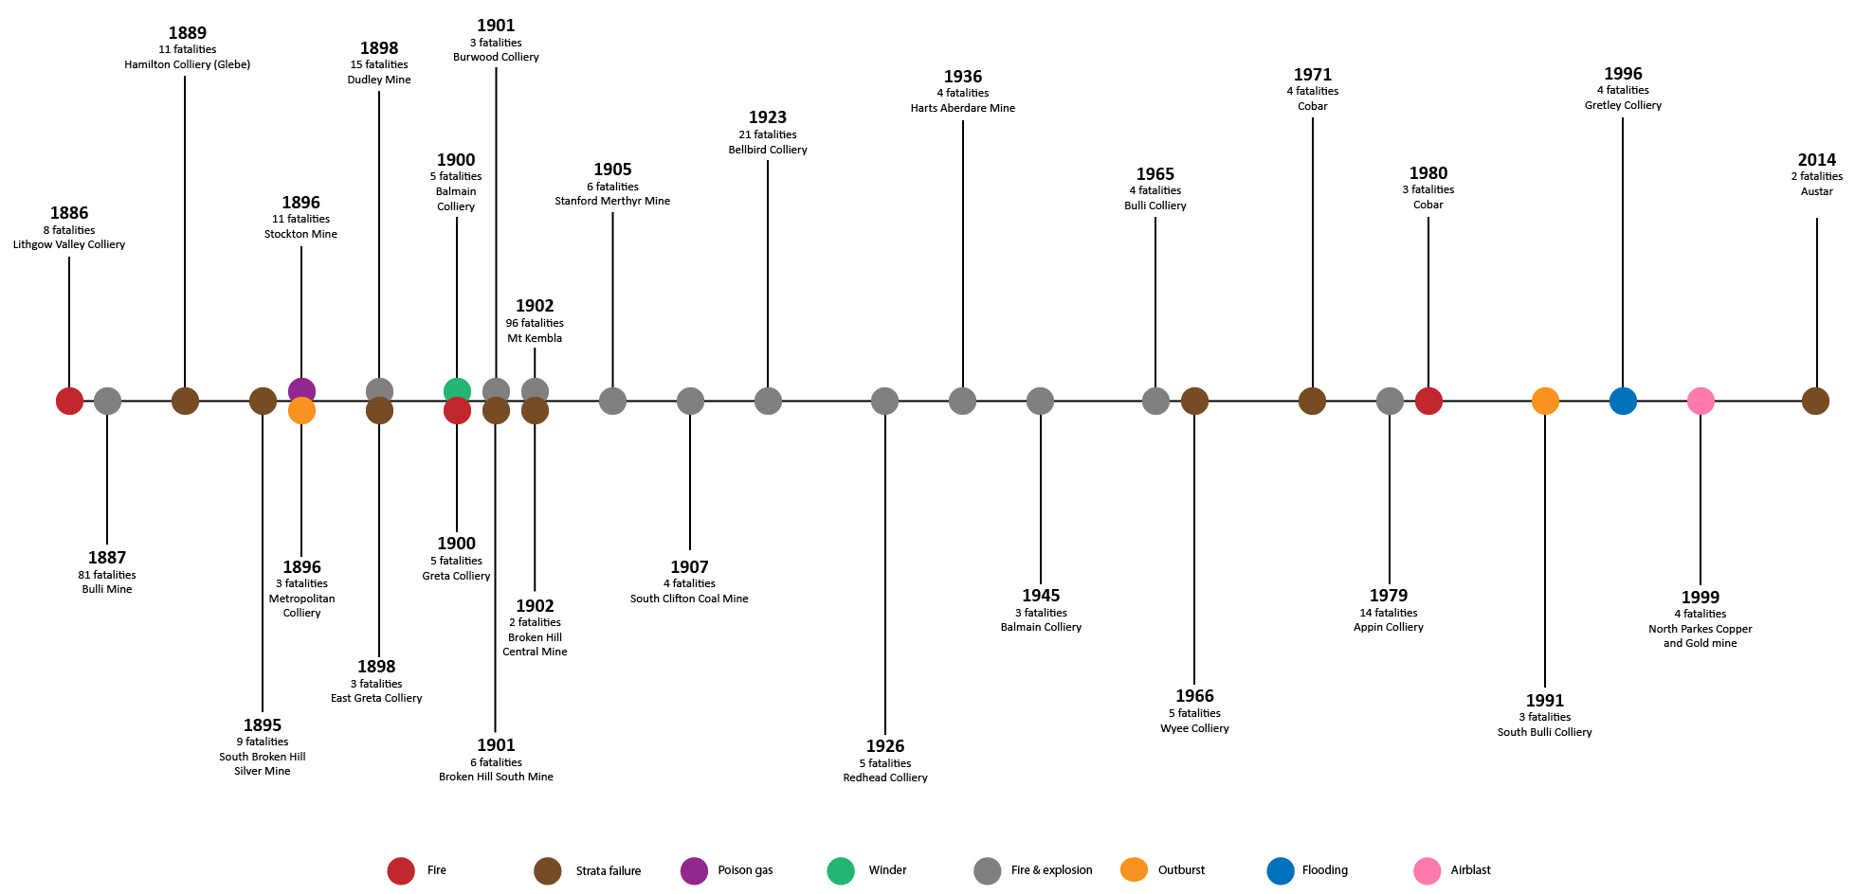
NSW mining disasters
Notes:
Suggested time for slides 3-6: 10 minutes (total)
Facilitator/key points:
As you can see from the table, there have been a number of major mining disasters in NSW since the late 1800s. These include the:
Bulli Mine explosion in 1887 with 81 fatalities
Dudley Mine Explosion in 1898 with 15 fatalities
Mt Kembla Explosion in 1902 with 96 fatalities
Bellbird Colliery explosion in 1923 with 21 fatalities
Appin Colliery explosion in 1979 with 14 fatalities.
And in more recent times the:
*Gretley Colliery flooding in 1996 with 4 fatalities; and
*Northparkes Copper and Gold mine airblast in 1999 with 4 fatalities
Austar rib/sidewall burst in 2014 with 2 fatalities.
Notes: *denotes a case study around that incident has been provided as part of this learning package.

Slide 4
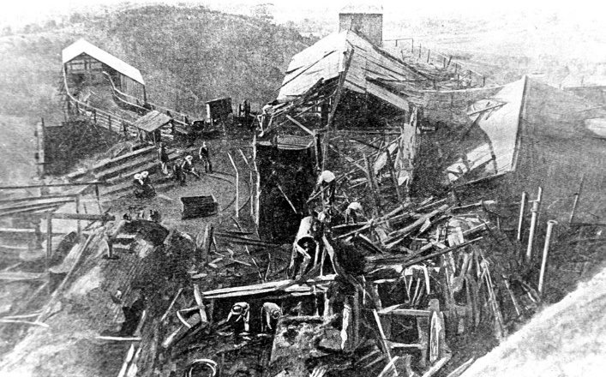
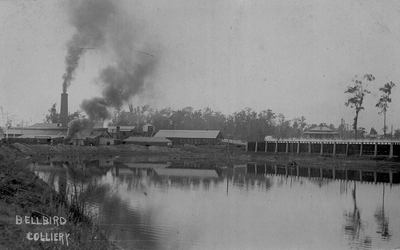
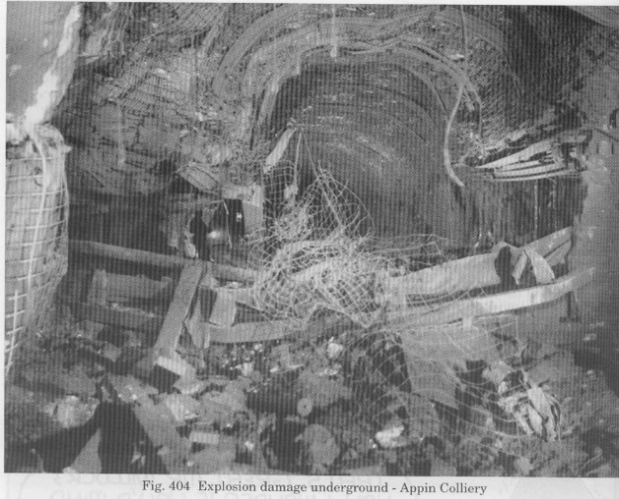
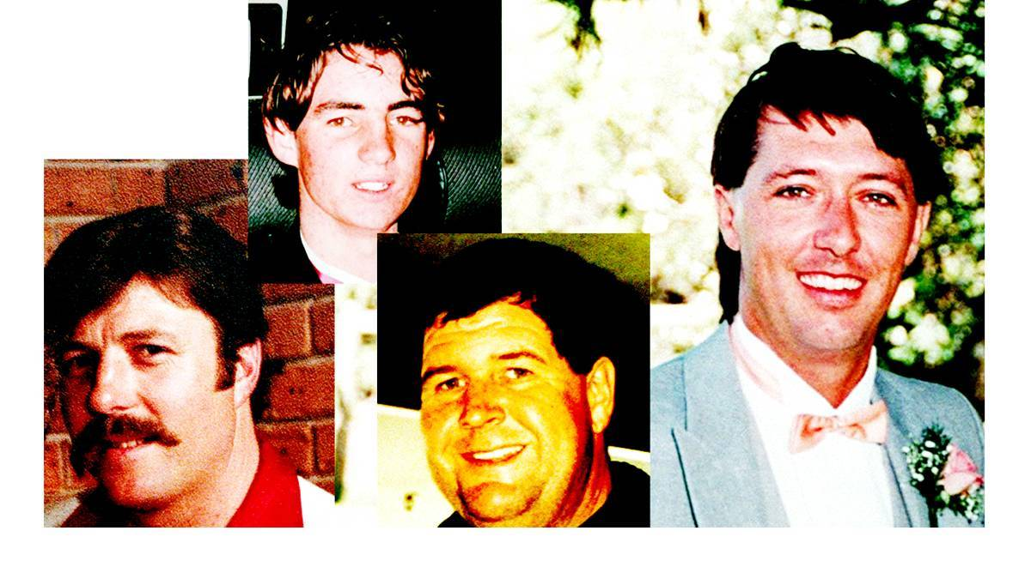
NSW mining disasters
96 fatalities Mount Kembla 1902
21 fatalities Bellbird 1923
14 fatalities Appin 1979
4 fatalities Gretley 1996
Notes:
Suggested time for slides 3-6: 10 minutes (total)
Facilitator/key points:
Mount Kembla 1902 – 96 fatalities
The Mount Kembla mine disaster was the worst post-settlement peace-time disaster in Australia, until the 2009 Black Saturday bushfires in Victoria. Mount Kembla was an underground coal mine in the Illawarra region of NSW.
On 31 July 1902, a large section of the unsupported roof in a goaf collapsed, pushing air and methane gas into the main tunnel. The rush of air and gas stirred up the coal dust clinging to the roof and walls of the workings and suddenly came in contact with a naked light. The gas ignited and, combined with the now airborne coal dust, set off the initial explosion that blew down the main tunnel with such force it took everything in its path. This initial explosion set off a series of explosions giving the miners no warning and no chance to escape. The explosion produced odourless carbon monoxide gas that filled the tunnels, accounting for more loss of life than the explosion itself.
The Royal Commission stated that only the substitution of safety lamps for flame lights could have saved the lives of the 96 victims.
The hazards that existed at Mt Kembla are present at many underground coal mines today. Mine operators have an obligation to manage risks to workers through the conduct of risk assessments, where controls must be implemented for identified hazards through the implementation of the hierarchy of controls.
Legislation prescribes matters that must be considered in implementing controls for gas and ventilation, fire, explosion (including explosion suppression), emergency management and training of workers.
Explosion protected equipment must be used in areas where gas is likely to be present and real-time monitoring systems provide mine operators with a continuous stream of data that allows for a proper understanding of the condition of a mines’ atmosphere at all times.
Bellbird 1923 – 21 fatalities
On 1 September 1923, explosions and fires underground killed 20 men at the Bellbird Colliery near Cessnock, NSW. Another man died in the rescue attempt, bringing the death toll to 21. The 21 victims left behind 38 children.
Inquests were unable to explain the cause of the fire. However, some accounts were critical of many unsafe work practices, including smoking in the mines, unreliable emergency phone lines and lack of hazard reporting and control. Some workers did not even have safety lamps.
Fifteen bodies were recovered from the site by rescue parties in the immediate aftermath of the explosion. The Coroner found the victims died from carbon monoxide poisoning.
In 1924, trained volunteer rescue teams using Proto breathing apparatus recovered the bodies of the six entombed miners. This demonstrated the value of a professional approach to mines rescue and advanced the cause of mines’ rescue stations. This disaster is considered to be the catalyst for the formation of the Mines Rescue Service in NSW in 1925.
Today, Coal Services Mines Rescue continues to provide training for rescue brigades-men in underground coal mines and has rescue stations in major coal fields in NSW. The mine safety legislative framework requires self-rescuers be carried by workers underground and self-contained breathing apparatus to be available along with suitable firefighting equipment for first response underground. Emergency escape systems and emergency management plans are also required.
Appin 1979 – 14 fatalities
On 24 July 1979 at the Appin Coal Mine on the NSW South Coast, an explosion, three kilometres from the pithead and 600 metres underground, killed 14 mine workers. The first three mine workers were killed by the explosion, while 11 mine workers died from carbon monoxide poisoning.
Judge Goran concluded that a methane explosion initiated a coal dust explosion following an accumulation of methane resulting from a flawed ventilation change and that the explosion began by an ignition in the fan starter-box and not the deputy’s safety lamp as initially speculated.
Judge Goran’s report called for electronic monitoring of gasses including portable devices for deputies and reinforced the need to have effective ventilation changeover practices including the need to cut the power to equipment during ventilation changeover and the necessity for an interlocking circuit to cut power to equipment if the auxiliary fan stops. It also recommended that ventilation officers be appointed. The issues identified in Judge Goran’s report are addressed by the current legislative framework.
Gretley 1996 – 4 fatalities
On 14 November 1996, four workers at the Newcastle Wallsend Coal Company's Gretley Colliery were killed as a result of an inrush of water from old workings.
The men were part of a crew of eight who were in the process of developing a roadway in an area of the mine, operating a continuous mining machine. Suddenly, with tremendous force, water rushed into the heading from a hole in the face made by the continuous miner. The machine, weighing between 35 and 50 tonnes, was swept 17 metres back down the heading where it jammed against the sides. The four men were engulfed by the water, swept away and drowned. The remaining team members were in the crib room a short distance away, which also flooded.
The water came from the long-abandoned mine at the Young Wallsend Colliery, which was full of water. The water extended to the surface through the mine shafts, significantly increasing the water pressure.
Justice Staunton prepared a report of a formal investigation. He accepted that many individuals within the mining industry assumed before the inrush that the 50 metre Borehole Rule in clause 9 of the Coal Mines Regulation (Methods and Systems of Working – Underground Mines Regulation 1984) offered adequate protection against inaccurate plans.
However, the errors in the Gretley plan were between 100 – 200 metres. The inquiry found the department, the mine operator and the mine surveyor all failed to identify the errors in the old workings. They each should have made efforts to confirm the accuracy of the old plan but failed to do so. There were also failings by mine deputies and the mine under-manager to properly investigate the source of water in the mine in the days and weeks prior to the inrush.
The current legislative framework requires certain actions by mine operators to identify and control inrush hazards. The mine operator must also prepare and implement a principal mining hazard management plan if it identifies an inrush or inundation principal mining hazard is present.

Slide 5
16 work-related fatalities in NSW (1 July 2010 – 30 June 2019)
Notes:
Suggested time for slides 3-6: 3 minutes (total)
Facilitator/key points:
From 1 July 2010 – 30 June 2019, there were 16 mining incident related deaths in NSW.
Facilitator should reinforce that all stakeholders in the industry need to be aware that the risk of fatality and serious injury occurs in all parts of the mining sector which requires everyone to remain vigilant and proactive in meeting their responsibilities.
Learning from experience, preventing devastating reoccurrences and improving the health and safety of all working in this industry is a profound way of acknowledging and recognising all those who have been impacted by mining safety incidents throughout history.

Slide 6
Support services available
Due to the potentially distressing nature of the video clips and content of the program, please note the following contact information for support services:
Beyond Blue: Phone: 1300 22 4636 (24 hours)
Web chat also available between 3pm and midnight at www.beyondblue.org.au
Lifeline: Phone: 13 11 14 (24 hours)
Web chat also available between 7pm and midnight at www.lifeline.org.au
Internal organisational welfare and support services
Notes:
Suggested time for slides 3-6: 10 minutes (total)
Facilitator/key points:
Prior to commencing the case studies and using any of the media or information, remind participants of the support services available to them should they find the content disturbing.

Slide 7
Professor Michael Quinlan – Ten pathways to death and disaster
Pathway 2
Failure to heed clear warning signals
Pathway 3
Flaws in risk assessment
Pathway 5
Flaws in system auditing
Pathway 1
Design, engineering and maintenance flaws
Pathway 4
Flaws in management systems
Pathway 10
Flaws in emergency procedures / resources
Pathway 6
Economic /reward pressures compromising safety
Pathway 7
Failures in regulatory oversight
Pathway 9
Poor management / worker communication / trust
Pathway 8
Worker, consultant and supervisor concerns prior to incident
Notes:
Suggested time: 4 minutes
Facilitator/key points:
This is an overview slide outlining the key pathways identified by Professor Quinlan. Further background information on Professor Quinlan is located on in the Facilitator Guide. A summary document of Quinlan’s ‘Ten pathways to death and disaster’ (which the Facilitator may have chosen to provide to participants prior to the training course) is provided in the ‘Participants Resources’ section of the Facilitator Guide.
Advise participants that research by several groups and individuals on fatalities and major safety incidents in mining over many years continues to identify these themes.
The themes are relevant in all mining contexts and in incidents involving both single and multiple fatalities.
Facilitators will need to ensure they do prior research and reading on the ten (10) pathways model so that they clearly understand the importance and relevance of each pathway.

Slide 8

Case study: Aberfan, UK
Fatalities: 144 (116 children)
Time 2:35
Notes:
Suggested time for slides 8-12: 3 minutes (total)
Case study – Aberfan, United Kingdom
Date:
21 October 1966
Location:
Merthyr Vale Colliery, Glamorgan, South Wales (UK)
Principal Hazard NSW Mining Legislation:
(i) ground or strata failure
(ii) inundation or inrush of any substance
Incident details
The Aberfan disaster was a catastrophic collapse of a colliery spoil tip in the Welsh village of Aberfan, near Merthyr Tydfil, on 21 October 1966, killing 116 children and 28 adults.
It was caused by a build-up of water in the accumulate rock and shale, which suddenly started to slide downhill in the form of slurry.
Over 40,000 cubic metres of debris covered the village in minutes, and the classrooms at Pantglas Junior School were immediately inundated, with young children and teachers dying from impact or suffocation.
Many noted the poignancy of the situation: if the disaster had struck a few minutes earlier, the children would not have been in their classrooms, and if it had struck a few hours later, the school would have broken up for half-term.
Great rescue efforts were made, but the large numbers who crowded into the village tended to hamper the work of the trained rescue teams and delayed the arrival of mineworkers from the Merthyr Vale Colliery. Only a few lives could be saved in any case.
The official inquiry blamed the National Coal Board (NCB) for extreme negligence. Parliament soon passed new legislation about public safety in relation to mines and quarries.
Human and organisational factors:
With few exceptions, regulators, government, the mine workers and the public had built a perception that the tip did not represent a risk to the community and efforts to manage risk were directed elsewhere.
Some members of the public had made complaints about the tip but the major concern had focused around the dumping of very fine material into the tip rather than the size of the dump. These protests were largely withdrawn when it was agreed not to dump any further fine waste on the tip.
Men were given tasks and held accountability that they were not competent to undertake.
A culture of poor communication and accountability existed within both the council and the NCB.
The NCB was aware of existence of spring underneath Aberfan mine tip yet failed to take action.
Critical controls
System to engineer and design debris pits
System to ensure monitoring and maintenance of debris pits
Systems to communicate information within organisation
Effective oversight by the regulator (NCB) – there was no policy that related to mine tips and had failed to take action in regard to pervious debris slides and minor slips leading up to the incident.
System of Training and Competency
Patterns of failure:
Design, engineering and maintenance
Failure to recognise debris pits as structures requiring maintenance
Failure to heed clear warning signals
Previous debris slides at Aberfan had occurred (1944, 1965). Rainfall in 3 weeks prior resembled 1944 experience. Slippage occurred day prior and day of the incident which could have triggered early warning system.
Flaws in risk assessment
Little/no risk management around debris tip management
Flaws in work health and safety management system
Lack of training and no accountability or responsibility of management to develop and maintain a safety system.
Flaws in system auditing
Failure to audit and inspect the structure of debris pit
Economic/reward pressures compromising safety
It was argued that the costs involved in removing debris tips may have led to job losses.
Failures in regulatory oversight
Role of the Inspectorate was only focused on mining underground.
No legislative imperative to inspect or manage debris pits.
Little technical knowledge and no requirement to undertake risk management of debris pits.
Worker, consultant and supervisor concerns prior to Incident
Failure by the engineers to communicate with staff or around attendances or concerns raised.
Poor management/worker communication/trust
Evidence of failure to share information on concerns or relevant incidents from local borough and workers
Flaws in emergency procedures/resources
Poor communication systems on site negated possibility of last minute warning being given to Aberfan village.
References:
http://aberfan.walesonline.co.uk/
http://www.mineaccidents.com.au/mine-accident/119/aberfan-disaster-1966
Source: Aberfan Tribunal Report
Additional material: “Drift into Failure” Sidney Dekker (2011)

Slide 9
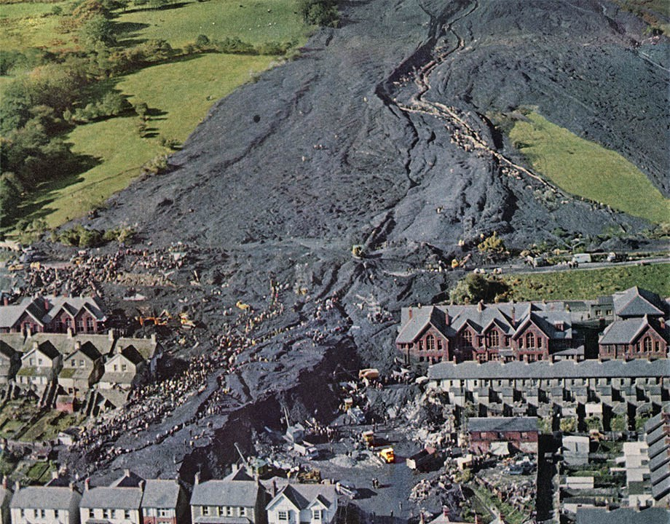
Case study: Aberfan, UK
21 October 1966
Principal Hazard – (i) Ground or strata collapse
Pattern of failure:
Design engineering and maintenance flaws
Failure to recognise debris pits as structures requiring maintenance.
2 . Failure to heed clear warning signals
Previous debris slides occurred at Aberfan in 1944 and 1965.
Rainfall in 3 weeks prior resembled 1944 experience.
Slippage occurred day prior and day of the incident which should have triggered early warning system.
Flaws in risk assessment
Little or no risk management around debris tip management.
Fatalities: 144 (116 children)
Notes:
See notes on first Aberfan slide

Slide 10
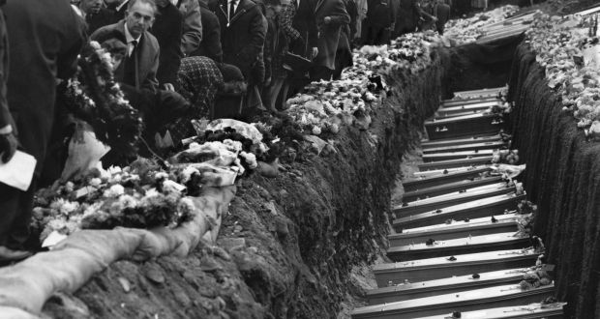
Case study: Aberfan, UK
Pattern of failure:
4. Flaws in work health and safety management system
Lack of training and no accountability or responsibility of management to develop and maintain a safety system.
5. Flaws in system auditing
Failure to audit and inspect.
6. Economic/reward pressures compromising safety
It was argued that the costs involved in removing debris tips may have undermined worker positions.
Fatalities: 144 (116 children)
Notes:
See notes on first Aberfan slide

Slide 11
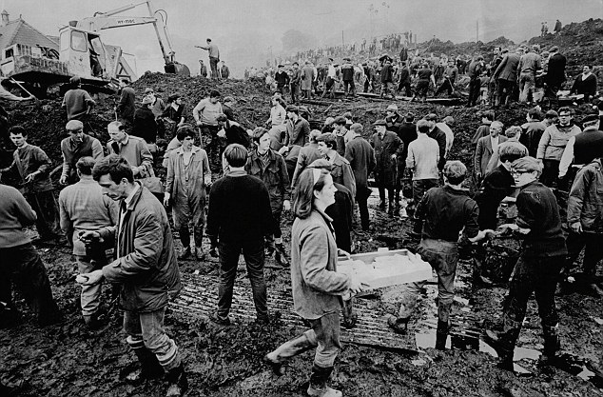
Case study: Aberfan, UK
Pattern of failure:
7. Failures in regulatory oversight
Role of the Inspectorate was only focused on safety of the miners.
Lack of legislative imperatives to inspect or manage debris pits.
8. Worker, consultant and supervisor concerns prior to incident
Failure by the engineers to communicate with staff or
around attendances or concerns raised.
Fatalities: 144 (116 children)
Notes:
See notes on first Aberfan slide

Slide 12
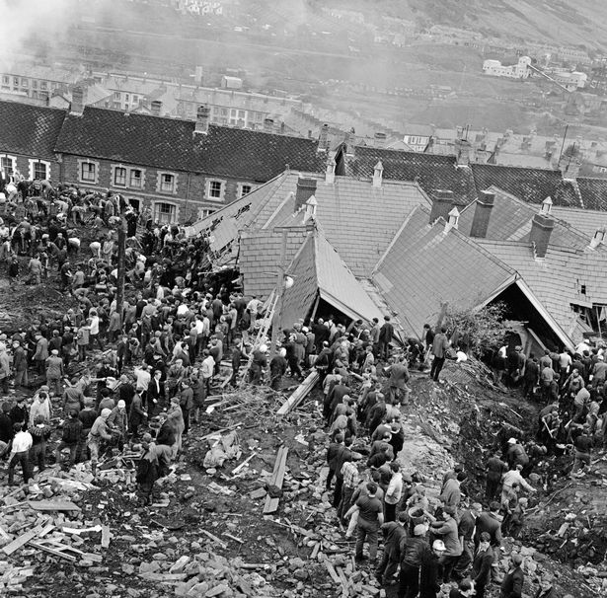
Case study: Aberfan, UK
Pattern of failure:
9. Poor management, worker communication and trust
Evidence of failure to share information on concerns or relevant incidents from local borough and workers.
10. Flaws in emergency procedures and resources
Poor communication systems on site negated possibility of last minute warning being given to Aberfan village.
Fatalities: 144 (116 children)
Notes:
See notes on first Aberfan slide.

Slide 13
Principal hazards in mining environments
Any activity, process, procedure, plant, structure, substance, situation or other circumstance relating to the carrying out of mining operations that have a reasonable potential to result in multiple deaths in a single incident or a series of recurring incidents in relation to any of the following:
(i) ground or strata failure
(ii) inundation or inrush of any substance
(iii) mine shafts and winding systems
(iv) gas outbursts
(v) spontaneous combustion
(vi) subsidence
(vii) roads or other vehicle operating areas
(viii) air quality or dust or other airborne contaminants (e.g. dust)
(ix) fire or explosion
(x) a hazard identified by the mine operator under clause 34 of the WHS Regulations
References: Work Health and Safety Regulation 2017 Part 3.1 (cl 34)
Work Health and Safety (Mines and Petroleum Sites) Regulation 2014 – Part 1 (cl 5)
Notes:
Suggested time for slides 13-14: 15 minutes (total)
Facilitator key/points:
Familiarise participants with the principal hazards as outlined in the legislation. Remind participants that these principal hazards are now in legislation because of their link to previous work, health and safety incidents. The current regulatory framework reflects the evolvement of the industry in response to past experience.
The facilitator is encouraged to explain that in many sites there may be several principal hazards that the management team will need to recognise and these hazards will be managed through the development, implementation, monitoring, evaluation and review of risk control strategies.
Lead the discussion on the hazards identified with the group with the objective of sharing experiences and strategies that various mine sites are adopting to manage their principal hazards.

Slide 14
Discussion activity #1 Identifying principal hazards
What are the principal hazard risks in your workplace?
Are there any hazards that are not specifically listed in the Regulations?
Notes:
Suggested time for slides 13-14: 15 minutes (total)
Facilitator/key points – Group based activity
Use the Activity Worksheet provided in the Participant Resources section of this guide.
Ask participants to discuss and identify how many of the legislated principal hazards they encounter in their workplace. Feedback the discussion where possible.
Encourage them to consider any other hazards that may not be listed such as confined spaces, working at heights or fatigue management for example.
Facilitator will ensure that participants are provided with the opportunity to identify and discuss other hazards (clause x) which mine sites are recognising and including in their Principal Hazard Management Plans.
Suggested questions to generate discussion could include:
How are mine sites currently identifying principal and other hazards?
What tools or strategies are used? Is the workforce (both management, employee and contractor) encouraged to pro-actively identify hazards or near miss situations?
Are the mine sites using lead or lag indicators in relation to hazard management? Are the hazard management strategies being led by operational or WHS management areas?
Have certain hazards been normalised in your mine sites?

Slide 15
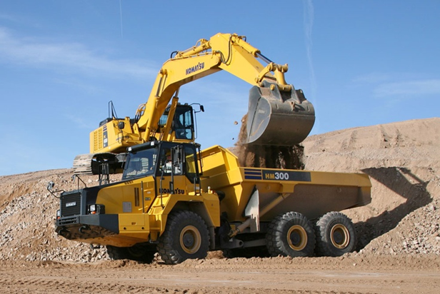
Case study reviews
Each of the following case studies involves pathways discussed by Professor Quinlan
Interaction heavy/light vehicles
Work (electrical) completed by an unqualified person
Ground/strata failure
Notes:
Suggested time for the three case studies: 30 minutes (total)
Facilitator/key points:
Facilitator will lead discussion on the three (3) selected case studies which provide evidence of the impact that the pathways can have in incident occurrences in this particular mining environment.
Facilitators are encouraged to remind participants to look at the broader work health safety themes of hazard identification, risk management and safe systems of work that are identified through the case studies rather than necessarily focusing on the specific factors of each incident.
NB: This two hour program has been structured so that only three case studies (Ravensworth; Cudal and Moolarben) are reviewed and discussed in detail. Noting that the Aberfan was covered off on briefly earlier, it is recommended that the Facilitator covers off on the remaining case studies briefly to create awareness of other types of mine disasters included in this training package.

Slide 16
Discussion activity #2 Learning the lessons
In groups reflect on the selected case studies (Ravensworth, Cudal and Moolarben) and Professor Quinlan’s 10 pathways.
Identify which of Professor Quinlan’s pathways you believer were a factor in each of the three case studies.
Discuss and identify two (2) of Professor Quinlan’s pathways that you believe present the greatest risk of a safety failure in your workplace.
Notes:
Suggested time for the three case studies: 30 minutes (total)
Facilitator/key points:
Facilitator will arrange groups for this activity. Groups can be site specific or mixed depending on group dynamics and participant mine locations.
Use the program activity workbook supplied in the Facilitator Guide to support Activity 2.
Facilitator will lead discussion on the impact the ten (10) pathways model had on the three case study examples previously provided ( Ravensworth, Cudal and Moolarben) and highlight the possibility that the themes presented could occur at the participant’s mine sites.
The discussion activity 2 template has a blank section for Quinlan’s ten pathways as this forms an activity for the group to identify which of Professor Quinlan’s pathways the participants believe were a factor in each of the three case studies.
Participants will work together to identify and discuss possible Quinlan pathway scenarios that are currently, or could potentially impact on their current mine sites. Responses can be recorded on the activity sheets.
The facilitator leads the feedback discussion from the group comments.
The identified pathways can be used as part of the discussion on the following section on WHS statutory responsibilities as all of the pathways have links and relevance to a range of duty holder legal responsibilities.
Facilitator will refer to the case study slides and work through the detail with the participants of each selected case study.

Slide 17
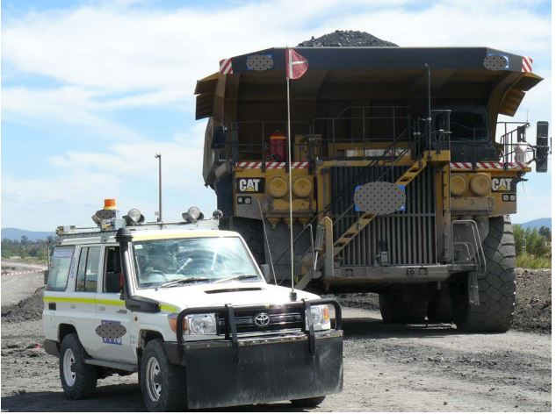
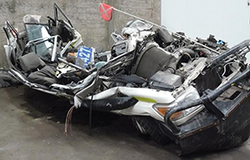
Case study: Ravensworth Mine, Hunter Valley, NSW
30 November 2013
Principal Hazard – (vii) roads or other vehicle operating areas
Pattern of failure:
Design engineering and maintenance flaws
Intersection design and signage.
Background lighting.
Poor visibility around the truck at night.
Absence of illumination devices to enhance visibility.
Lack of collision avoidance systems.
Over reliance on administrative controls.
Fatalities: 1 miner
Notes:
Case study– Ravensworth Mine, Hunter Valley, NSW
Date
30 November 2013
Location
Ravensworth Mine, Liddell, NSW
Principal Hazard NSW Mining Legislation
(vii) roads or other vehicle operating areas
Incident details
A mine worker suffered fatal injuries when the Toyota Landcruiser they were driving collided with, and was run over by, the front right-hand side wheel of a haul dump truck (Caterpillar 793D), weighing approximately 351tonnes (including 186 tonnes of coal).
The driver was the only occupant of the Landcruiser vehicle and approached a T-intersection with the stockpile ramp and proceeded to turn into the path of the truck. The truck operator saw the Landcruiser enter the haul road on their right but then lost sight of it.
Approximately 10 months later 4 people died in a similar fatal accident on the Freeport Copper Mine, Papua Province, Indonesia when a Caterpillar 785 haul truck also accidentally collided with a shift change light vehicle with nine occupants.
Human and organisational factors
The driver may have recognised the presence of the intersection but was not able to detect the truck and/or observed the truck, but misinterpreted the road environment presented and what was required. (P. 2)
Traffic management systems and the interaction between light and heavy vehicles on haul roads may have created the opportunity for collision.
Design and construction of road bunding failed to consider possibility for obscuring visibility for light vehicles.
Due to the height of the truck and its close proximity to the intersection, the lack of light coming from the bumper lights would have made it difficult for the Landcruiser driver to see the truck.
Neither vehicles had proximity alert or collision avoidance systems installed. This is not currently legislated but is emerging best practice.
Critical controls
Mine engineering and design standard for haul roads and intersections
Traffic management system regarding light and heavy vehicle interaction
Training and Competency System for operating light vehicles
Mine processes for lighting
Light vehicle specification and maintenance system
Patterns of failure
Pathway 1 Design, engineering and maintenance flaws
Inv Report - Contributory factor #2
Some aspects of the intersection design and signage did not meet Ravensworth mine’s guidelines and/or ARRB best practice.
Inv Report - Contributory factor #4
The background lighting near the intersection had the potential to disorientate or confuse drivers approaching the intersection on the 8th ramp.
Inv Report – Contributory Factor #6
The poor visibility of the truck due to the obscured front bumper lights and recessed right side low beam may have contributed to the incident by limiting the visibility of the truck that night.
Inv Report - Contributory factor #7, #9
Absence of other illumination devices on the truck to enhance visibility.
No proximity or collision avoidance systems installed on the truck or Landcruiser to warn operators of the presence of another vehicle.
Inv Report - Contributory factor #10
An over-reliance on administrative controls to manage heavy and light vehicle interactions at Ravensworth mine.
References
Investigation report
Investigation into a fatal collision between a Caterpillar 793D haul dump truck and a Toyota Landcruiser at Ravensworth open cut mine on 30 November 2013.
Report prepared by the NSW Mine Safety Investigation Unit for the Secretary of NSW Trade & Investment
March 2015
https://www.resourcesandenergy.nsw.gov.au/__data/assets/pdf_file/0005/553523/Ravensworth-Investigation-Report.pdf
https://www.sbs.com.au/news/deaths-at-us-mine-in-indonesia

Slide 18
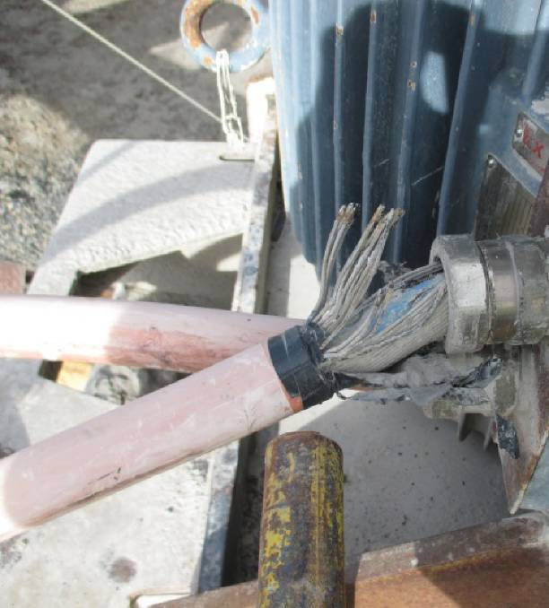
Case study: Cudal Limestone Quarry, Cudal, NSW
27 August 2014
Principal Hazard – (x) a hazard identified under clause 34
Pattern of failure:
1. Design engineering and maintenance flaws
Failure to meet wiring requirements
Inadequate engineering to include multiple barriers to electric shock
5. Flaws in system auditing
No Earth to Neutral (E-N) link at main switchboard
Non compliant electrical work
Fatalities: 1 neighbouring resident
Notes:
Case study – Cudal Limestone Quarry, Cudal NSW
Date
27 August 2014
Location
Cudal Limestone Quarry, Cudal, NSW
Principal Hazard NSW Mining Legislation
Under WHS Act
Incident details
A resident of a neighbouring property to the Cudal Limestone Quarry was found deceased. The house was supplied with electricity from the quarry’s electrical supply. The deceased woman appeared to have suffered a fatal electric shock.
The house was approx. 250m from the crushing plant which was supplied by a three-phase overhead line.
Electrical testing identified that when the electrical supply was on and the crushing plant was operating, excessive voltage appeared at the house earth stake and water pipes. A phase-to-earth fault was identified on a motor supply cable.
Human and organisational factors
The organisation allowed a non-compliant electrical installation to operate on the site.
Electrical work at the site was not completed to a sufficient standard to meet legislative and Australian Standard requirements.
Critical controls
Site standard and statutory compliance program for electrical installations
Site electrical maintenance program
Site electrical inspection program
Site program for training and competency for electrical work
Patterns of failure
Pathway 1 Design, engineering and maintenance flaws
Lack of safety devices “The absence of the earth to neutral link at the quarry switchboard does not meet the requirements of the wiring rules for a MEN earthing system” (P.4)
Insufficiently engineered and maintained electrical system.
Pathway 5 Flaws in system auditing
Non-compliant electrical work. At the main switchboard, it was observed that no earth to neutral link (E-N link) was fitted. The absence of the E-N link at the main switchboard resulted in an increase in the earth fault loop impedance from the motor of the crushing plant to the supply transformer. This increased fault loop impedance resulted in a voltage rise on the neutral conductors throughout the quarry supply system during and electrical fault condition. The earth leakage relay did not activate during the fault event.” (P.3)
References
Information release – NSW Mine Safety Investigation Unit 3 February 2015
https://www.resourcesandgeoscience.nsw.gov.au/__data/assets/pdf_file/0009/542475/IIR15-01-Fatality-at-house-near-quarry.pdf

Slide 19
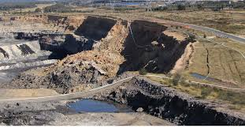
Case study: Moolarben Coal Operations, Ulan, NSW
6 June 2015
Principal Hazard – (1) ground or strata failure
Pattern of failure:
Design engineering and maintenance flaws
Potential for instability had been identified but
the impact on the roadway not considered
Flaws in risk assessment
Measures implemented to manage the risk were
insufficient if preventing the failure of the highwall
4. Flaws in management systems
Improved monitoring may have assisted in isolating the area and controlling the adjacent public road.
Fatalities: 0
Public road adjacent
Notes:
Case study – Moolarben Coal Operations, Ulan, NSW
Date
6 June 2015
Location
Moolarben Coal Operations, Ulan, NSW
Principal Hazard NSW Mining Legislation
(i) Ground or strata failure
Incident details
Regular open cut mining operations were being undertaken on the morning of 6 June 2015 when a section of the highwall adjacent to a public road failed. There was nobody in the immediate area at the time of the slump.
The failure was about 160 m wide and approximately 55 m high. The highwall edge before the failure was 40 m from a public road and 12 m after the failure.
Contributing factors
A palaeochannel infill sequence of materials had been exposed during recent mining operations. It included materials that had not been identified in geological modelling. A palaeochannel is a remnant of an inactive river or stream that has been filled or buried by younger sediment. This palaeochannel was locally deeper than previously exposed and comprised of differing lower level sediments. The increased thickness of the channel consisted of relatively loose silty sands and weaker clays which were at the base of the palaeochannel infill at the top of the coal seam.
The upper 25 m of materials were stiffer and stronger and it is believed these have caused overstressing of the clays and infill sands. Undrained pore pressure is believed to have triggered localised liquefaction and lubricated the fissures within the clays.
Human and organisational factors
Inspections and geo-technical data failed to identify the paleochannel.
The organisation and management team believed that that the additional monitoring and the implementation of the buttress wall would be sufficient to prevent slippage.
Critical controls
Mine monitoring and inspection system
Authority to mine process
Mine planning process
Patterns of failure
Pathway 1 Design, engineering and maintenance flaws
The mine had previously recognised potential for instability in the northern highwall. The wall design reflected this. Further, the mine had implemented routine measurements of the sidewall crest and periodic face scanning. Groundwater monitoring was being undertaken as well as increased inspections by the mine’s geotechnical consultant.
Pathway 2 Failure to heed clear warning signals
The failure to detect the localised change in the palaeochannel at exploration meant that no adjustment to the wall design, or change to the mining sequence, was possible and the failure of the highwall was unable to be prevented during the mining process.
Pathway 3 Flaws in risk assessment
The change in the area of the last strip was identified during excavation and the mine organised an inspection by their geotechnical consultant. He identified an additional control of a 25 m coal buttress to be left in situ in front of the deepest areas of paleo channel material. This was put in place on 29 May 2015. This additional control provided for increased separation for mining equipment, however it was not sufficient to prevent the failure of the highwall.
Pathway 4 Flaws in management systems
Improved monitoring of the area from 29 May 2015 would not have prevented the failure but may have assisted in ensuring that no people could have been put at risk, by isolating the area and controlling the adjacent public road. It is unlikely that monitoring would have provided for adequate warning to allow for backfilling in the area in a safe and timely manner.
References
High potential incident – Open cut highwall failure adjacent to a public road. Moolarben Coal Operations adjacent to Ulan-Wollar Road, Mudgee
https://www.resourcesandgeoscience.nsw.gov.au/__data/assets/pdf_file/0008/585836/IIR15-04-Moolarben-highwall-failure.pdf

Slide 20
Case study: Pike River, New Zealand
Fatalities: 29 miners
Time 13:20
Notes:
Suggested time for slides 20-23: 15 minutes (total)
Case study – Pike River Mine, New Zealand
Date
19 November 2010
Location
Pike River Mine, Greymouth, South Island, New Zealand
Principal Hazard NSW Mining Legislation
(ix) Fire or explosion
Incident details
At 3.45pm there was an underground explosion at the Pike River coal mine resulting in 29 fatalities.
Human and organisational factors
The cost of the mine development had exceeded its budget.
Mine production had failed to meet the anticipated targets and the commitments given to stakeholders resulting in production pressure to complete unsafe work.
The company ignored advice regarding risks associated with placing a main ventilation fan underground.
High rates of staff turnover and inability to attract and retain skilled staff compromised safety systems.
Lack of appropriate resources related to WHS systems and auditing.
Critical controls
Introduction to site process
Regulatory and legislative over-sight regarding 2nd egress
Regulatory and legislative over-sight regarding main ventilation fan location
Risk management controls for hydro mining technique
Mine systems to prevent prohibited items/contraband UG
Patterns of failure
Pathway 1 Design, engineering and maintenance flaws
Hydro mining and main ventilator
Pathway 2 Failure to heed clear warning signals
Failure to respond to trends in atmospheric pressure and methane levels
Pathway 3 Flaws in risk assessment
Failure to risk assess hydro mining or UG main ventilator
Pathway 4 Flaws in management systems
Failure to maintain safety critical systems – rock dusting, ventilation, equipment
Failure 5 Flaws in system auditing
No proper OHS audit
Pathway 6 Economic/reward pressures compromising safety
Production pressure/cost cutting compromising safe work practices + incentive pay systems encouraging unsafe work practices
Pathway 7 Failures in regulatory oversight
Insufficient/inadequately trained or supervised inspectors
Inadequate/poorly targeted enforcement
Flaws in legislation – standards, reporting requirements, sanctions, workers’ rights
Pathway 8 Worker, consultant and supervisor concerns prior to incident
Supervisor, consultant and worker concerns at Pike River
Pathway 9 Poor management/worker communication/trust
Poor management response to worker, supervisor and union concerns
Pathway 10 Flaws in emergency procedures/resources
No second egress
References
Final Report Pike River Royal Commission (30 October 2012)
http://pikeriver.royalcommission.govt.nz/Final-Report
“Ten Pathways to Death and Disaster”, Michael Quinlan (2014)

Slide 21
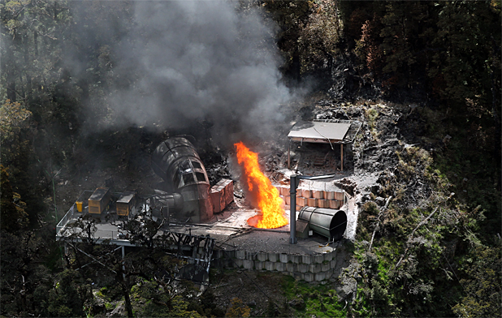
Case study: Pike River, New Zealand
19 November 2010 - Principal Hazard – (ix) Fire/explosion
Pattern of failure:
1. Design, engineering and maintenance flaws
Decision to use hydro mining and the positioning of the main mine ventilation fan.
2. Failure to heed clear warning signals
Failure to respond to trends in atmospheric pressure and methane levels.
3. Flaws in risk assessment
Failure to risk assess hydro mining or UG main mine ventilation fan.
4. Flaws in management systems
Failure to maintain safety critical systems – stone dusting, ventilation, equipment.
Fatalities: 29 miners
Notes:
Refer to notes on first Pike River slide.

Slide 22
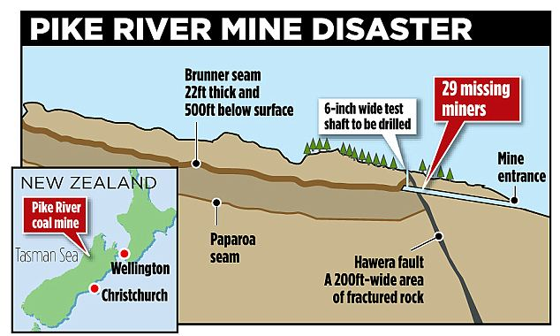
Case study: Pike River, New Zealand
Pattern of failure:
5. Flaws in system auditing
No proper OHS audits conducted.
6. Economic/reward pressures compromising safety
Production pressure/cost cutting compromising safe work practices and incentive pay systems encouraging unsafe work practices.
7. Failures in regulatory oversight
Insufficient/inadequately trained or supervised inspectors.
Inadequate/poorly targeted enforcement.
Flaws in legislation – standards, reporting requirements, sanctions, workers rights.
Fatalities: 29 miners
Notes:
Refer to notes on first Pike River slide.

Slide 23
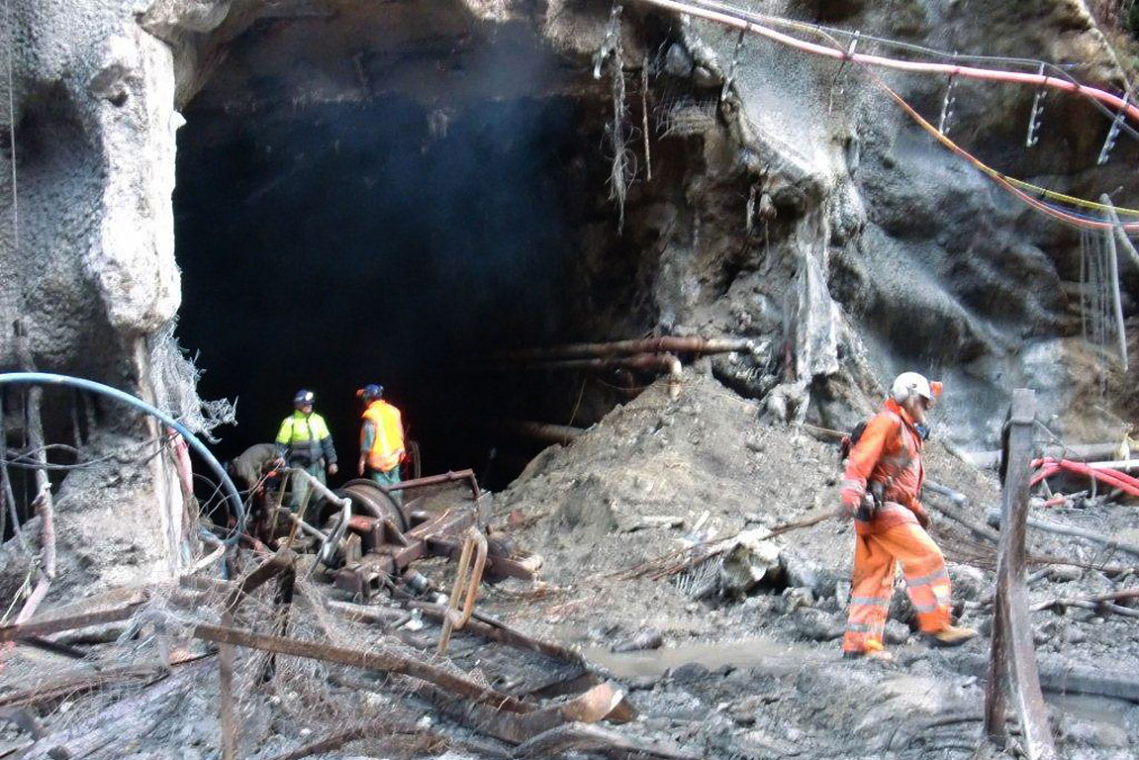
Case study: Pike River, New Zealand
Pattern of failure:
8. Worker, consultant and supervisor concerns prior to incident
Failure to respond to supervisor, consultant and worker concerns about safety.
9. Poor management, worker communication and trust
Poor management response to worker, supervisor and union concerns leading to non-productive relationships.
10. Flaws in emergency procedures/resources
No second egress.
Unsatisfactory emergency response procedures post incident.
Fatalities: 29 miners
Notes:
Refer to notes on first Pike River slide.

Slide 24
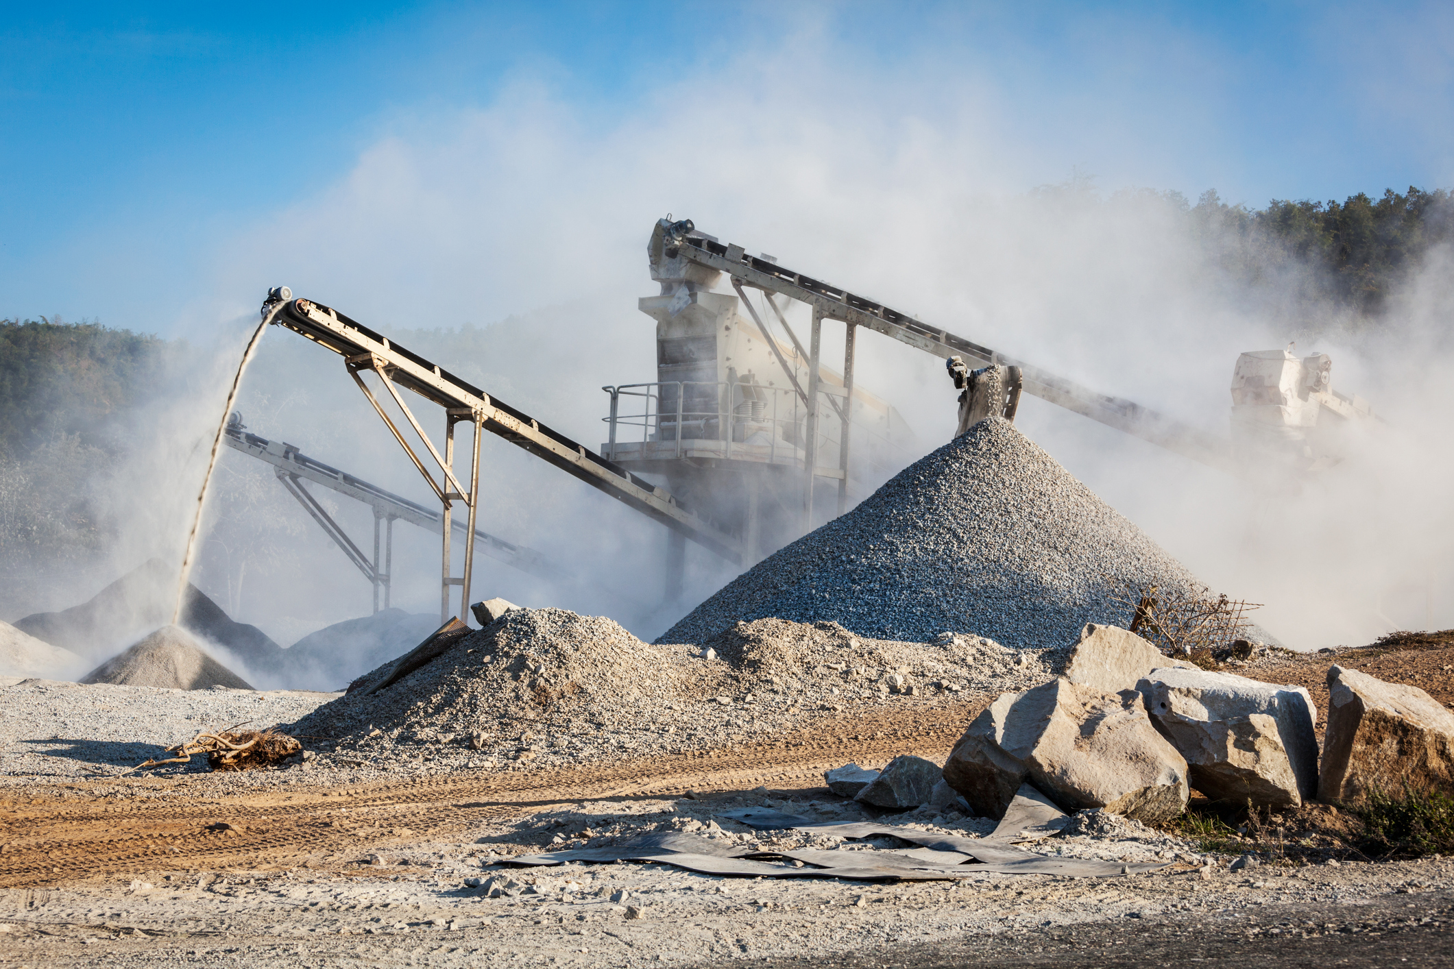
Responsibilities for safety on mine sites
The legal framework for safety as it applies to:
Mine Operators
Quarry Managers
Contractors
Workers
Notes:
Suggested time for slides 24-29: 10 minutes (total)
Facilitator/key points:
These slides are to remind participants that this is the legislated framework that outlines the shared responsibility and obligations of everyone involved in the mining sector to ensure the health and safety of all those working in the industry. Many of the incidents involving fatalities/injuries or the exposure to serious risk highlighted failures at all levels of the specific organisation.
Facilitator will provide detailed information on each duty holder and the range of accountabilities and responsibilities each needs to meet to discharge their duties under the NSW WHS laws and regulations applying to mines and petroleum sites.
Facilitator should identify the links to the ten (10) pathways model to relevant duties identified in the legislation as they work through each point and duty holder slide.
Discussion should be encouraged as this section of the presentation will allow participants to contextualise their job roles with current workplace situations and promote discussion on possible solutions to overcoming pathway issues.
Relationship with the WHS Act
The WHS (Mines and Petroleum Sites) Act 2013 is to be construed with and as if it formed part of the WHS Act 2011, and the regulations under this Act are to be construed with and as if it formed part of the WHS regulations. See section 4 of the WHS (Mines and Petroleum Sites) Act 2013.
The duty holder’s responsibilities are identified in the following sections of the Act:
PCBU (person conducting a business or undertaking) – reference section 19 of the WHS Act 2011
Officers-reference section 27 of the WHS Act 2011
Workers-reference section 28 of the WHS Act 2011
PCBU in control of workplace-reference section 20 of the WHS Act 2011
Identify the various legal tests each duty holder will be held to in a court of law. It is important for the facilitator to effectively articulate the application of these tests in relation to how duty holders discharge their relevant duties as this is particularly relevant when determining possible risk controls to deal with each of the matters identified in Quinlan’s ten (10) pathways.
The Facilitator is encouraged to identify and discuss the following tests:
PCBU – reasonably practicable (see section 18 of the WHS Act 2011)
Reasonably practicable means that which is, or was at a particular time, reasonably able to be done to ensure health and safety, taking into account and weighing up all relevant matters including: (a) the likelihood of the hazard or the risk concerned occurring (SafeWork Australia).
PCBU in control of a workplace- reasonably practicable (see section 18 of the WHS Act 2011)
Reasonably practicable means that which is, or was at a particular time, reasonably able to be done to ensure health and safety, taking into account and weighing up all relevant matters including: (a) the likelihood of the hazard or the risk concerned occurring (SafeWork Australia).
The Officer-due diligence test (a person who has whole or substantial control of an organisation/PCBU)-see section 27 of the WHS Act 2011
In demonstrating due diligence, section 27 of the WHS Act requires officers to show that they have taken reasonable steps to:
acquire and update their knowledge of health and safety matters
understand the operations being carried out by the person conducting the business or undertaking (PCBU) in which they are employed, and the hazards and risks associated with the operations
ensure that the person conducting the business or undertaking has, and uses, appropriate resources and processes to eliminate or minimise health and safety risks arising from work being done
ensure that the person conducting the business or undertaking has appropriate processes in place to receive and respond promptly to information regarding incidents, hazards and risks
ensure that the person conducting the business or undertaking has, and uses, processes for complying with duties or obligations under the WHS Act. For further information about what is ‘reasonable’, refer to Safe Work Australia (Comcare: Guidance for Officers in Exercising Due Diligence)
Worker-reasonable care test-see section 28 of the WHS Act 2011.
A worker has a responsibility to take reasonable care of their own health and safety, and that of others. A worker is a person who carried out work in any capacity for a business or employer (or other PCBU). They can be: an employee, contractor, sub-contractor, labour hire worker, a trainee, apprentice or work experience student (SafeWork NSW).
Practical Application of Tests:
In a practical day to day sense most managers, supervisors and workers are defined as workers under the current WHS legislation and are therefore required to discharge their duties to a level of reasonable care.
This means that this group of workers will have had specific WHS management tasks and obligations delegated to them from the organisations officers (i.e.: CEO, CFO) through their Principal Hazard Management Plan (PHMP) and Work Health and Safety Management Systems (WHSMS).
It is important to confirm that attendees at this course are fully aware of their responsibilities under the legislation.
In a practical sense the role of the operational manager and their workers is to ensure the systems, policies, procedures, tools and guidelines developed by the organisation in response to their legal responsibilities are completely understood and are fully implemented, monitored, evaluated and reviewed especially in relation to the identification of hazards and implementation of risk controls.
While the test for the PCBU as the primary duty holder is reasonably practicable many mining organisations operating in Australia and across the world are intent on bettering this standard through seeking to become High Reliability Organisations (HROs).
HROs have characteristics such as:
Continuous technical learning through extensive training and exercises that captured all potential ‘failure scenarios’;
Good incident reporting culture and analysis of accidents and near misses to gain a realistic picture of the organisation’s state of operations;
Good two-way communications between operators and management; and
A combination of centralised and de-centralised decision-making.
By undertaking your role in a dedicated and pro-active fashion you will be placing systematic, behavioural and organisational barriers against the pathway/s of disaster identified by Professor Michael Quinlan.

Slide 25
Responsibilities for safety on mine sites – mine operators
The Operator who is the primary PCBU on site must ensure:
Provision and maintenance of a workplace without risk to health and safety
Provision and maintenance of safe plant and structures
Provision and maintenance of safe systems of work
Safe use, handling, and storage of plant, structures and substances
Provision of adequate facilities for welfare at work
Provision of information, training, instruction or supervision
The monitoring of the health of workers and conditions at the workplace
Reference: S. 19 NSW Work Health and Safety Act 2011 No 10 – primary duty of care (PCBUs)

Slide 26
Responsibilities for safety on mine sites – Quarry Managers
Access, understand, apply and monitor the relevant parts of the Safety Management System (SM)S including hazards
Source and apply current knowledge relating to WHS risks strata failure
Lead the management of risk, including risk assessment processes
Develop, apply and monitor risk controls
Maintain the currency of standards and procedures applied under the SMS
Implement training, instruction and assessment of workers
Reference: Statutory function description – NSW Resources Regulator

Slide 27
Responsibilities for safety on mine sites – Quarry Managers
Facilitate WHS consultation, coordination and cooperation
Investigate incidents
Conduct and monitor workplace inspections for hazards, risk and suitable controls
Report to the mine operator deficiencies or significant deviations
Supervise general mining operations as required by SMS
Reference: Statutory function description – NSW Resources Regulator

Slide 28
Responsibilities for safety on mine sites – contractors
The contractor must provide all relevant information to the operator to enable the operator to identify risks associated with proposed operations
There are two options on how a contractor interacts with the mine’s Safety Management System (SMS)
  Option 1:
  Contractor prepares a Health & Safety Management Plan and provides it to operator
  Operator reviews Plan and gives written notice to contractor that it is consistent with the SMS of the mine
  Option 2:
  Contractor reviews the relevant parts of the mine’s SMS.
  Contractor gives operator written notice they have reviewed SMS and that it is consistent with the contractors arrangements for managing health & safety as per clause 9 of WHS(MPS) Regulations & WHS laws
References: cl. 21 and cl. 22 of the NSW Work Health and Safety (Mines and Petroleum Sites) Regulation 2014 and S. 46 of the WHS Act 2011 (Consultation)

Slide 29
Responsibilities for safety on mine sites – workers
Take reasonable care for your own heath and safety
Take reasonable care that your actions or your failure to act do not adversely affect the health and safety of others
Comply with any reasonable instruction that allows the mine manager or operator to comply with the Act
Co-operate with any reasonable safety policy or procedure
Reference: S. 28 of NSW Work Health and Safety Act 2011

Slide 30
Discussion Activity #3 Implementing the Lessons
Consider the two Professor Quinlan’s pathways that you identified in Activity 2 as presenting the greatest risk of a safety failure in your workplace
What are three things you are going to do when you go back to your workplace to address these two Quinlan pathways?
Each group will be asked to present their views for discussion
Notes:
Suggested time: 15 minutes
Facilitator/key points
Facilitator will continue the group activity and encourage participants to reflect on the two Quinlan pathways identified in Activity 2.
Using the program activity workbook supplied assist participants to think about what actions they as individuals they will take when they go back to their workplace to address these risk areas.
Encourage participants to reflect on why the gaps exist. For example, is there a lack of training? Is there poor engagement and consultation? By understanding the barriers to developing strong safety systems of work, the participants will be better able to develop strategies that are likely to be more successful and sustain improved safety outcomes at their workplace.
The facilitator should reinforce that a key part of a leadership role is the development of action strategies to address risk and identified opportunities for improvement.
Encourage participants to think about what type of control options/strategies could be implemented for each of these areas to improve the safety outcomes in their workplace.
Encourage participants to attach responsibility and time frames (where appropriate) or to develop a suitable pathway to commence any work, health and safety improvement processes at their mine
Participants need to have a clear understanding about what the key takeaway learnings are for their quarry and should be encouraged to go away and reflect on this further and make/report any changes necessary at their mine to improve work, health and safety processes at their workplace.
The facilitator leads the feedback discussion from the group comments.

Slide 31
Case study: Northparkes Mine, Parkes, NSW
Rob Cunningham Mining Operations Manager Northparkes Mine
Time 4:30
Notes:
Suggested time for slides 31-36: 10 minutes (total)
NB: Slides 331-36 are the remaining case studies for the Facilitator to briefly touch on (Northparkes; Gretley; Cadia East).
Case study – Northparkes Mine, Parkes NSW
Date
24 November 1999
Location
Northparkes Mining, Parkes NSW
Principal Hazard NSW Mining Legislation
(i) Ground or strata failure
Incident details
The incident occurred during a period of maintenance shut down in Northparkes E26 Mine. At the time there were approximately 65 persons working underground.
At about 2.50 pm the ore body above the cave back collapsed into the void, creating an air blast which travelled through underground workings of the mine, in particular through the exploration drive at One Level.
Human and organisational factors
The risk assessment process failed to effectively identify the scope of risks associated with the activity which was uncommon in the industry at the time.
The organisation did not have a comprehensive system in place for managing change in mining methods or process changes.
The organisation failed to take action to correct engineered safety controls when they were compromised by the mining method adopted.
Hazard management procedures required more specific definition
(e.g., zones within the mine and muckpile heights).
Critical controls
Mine Risk Management system
Mine inspection and monitoring arrangements
Change Management and approvals to mine process
Patterns of failure
Pathway 1 Design, engineering and maintenance flaws
The usefulness of the bulkhead as a safeguard against air blast on One Level was negativised by allowing the bulkhead to come into the zone of influence of subsidence of the cave and allowing the dog-leg cuddy to also come into the zone of influence of subsidence in the cave. Finding 7(b)
Pathway 2 – Flaws in risk assessment
Any mining operator intending to employ the process of block cave mining is to identify and analyse the elements of all the risks associated with its block cave operations and develop and maintain hazard management procedures for the management of the void of the muck pile, height of the muck pile above the extraction level and, air blast hazard and shall include all the appropriate controls for the air blast all opening and potential openings into the cave zone. Recommendation 3
Pathway 3 – Flaws in management systems
Failure of the company to assure the safety system including risk management and critical controls were in place and functioning.
That North Parkes Mine should have been aware that the position of the bulkhead as a safety guard against air blast on One Level had been compromised and no longer served that purpose before the 24.11.1999. (Finding 7c)
Pathway 4 Economic/reward pressures compromising safety
For production to continue, the extraction rate of the ore was in volumes greater than those which were falling from the cave back. This in turn created a void between the cave back and the top of the muck pile on the extraction level – this void increased with time and eventually the air void was some 180 m in height. (P i)
“I find the only reason that the air gap void was allowed to become as large as it was….was that North Parkes Mines maintained a production rate far greater than the rate at which the ore was falling from the cave back. It is quite clear that the production rate took precedence over factors which concerned the safety of those within the mine.” (Finding 4)
References
Findings and Recommendations – John Bailey, Coroner (2003)
Re: Inquest into the deaths of R Bodkin, M House, S Osman and C Lloyd-Jones on the 24th November 1999 at the E26 Lift 1 Mine North Parkes Mines, Parkes NSW.
http://eagcg.org/common/pdf/NorthParkesCoronial.pdf

Slide 32
Case study: Northparkes Mine, Parkes, NSW
Block cave mining at Northparkes Mines
Time 3:10
Notes:
This video provides background information on black cave mining at Northparkes.

Slide 33
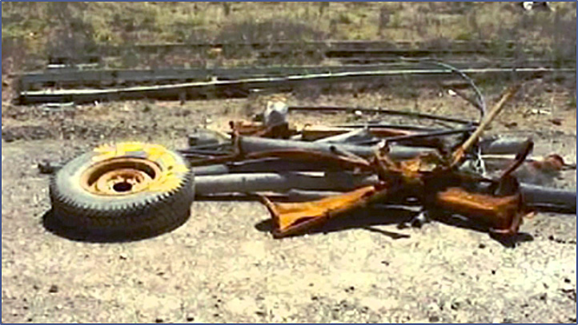
Case study: Northparkes Mine, Parkes, NSW
24 November 1999
Principal Hazard – (i) inundation or inrush of any substance
Pattern of failure:
Design engineering and maintenance flaws
Allowing the bulkhead which was acting as a safeguard to come into the zone of influence of subsidence in the cave.
Flaws in risk assessment
Failure to appreciate the risks associated with the muck pile.
4. Flaws in management systems
Failure to recognise that the positioning of the bulkhead as a safety guard had been compromised.
6. Economic/reward pressures compromising safety
‘Production rate took precedence over factors which concerned the safety of those within the mine’ – Coroner Bailey.
Fatalities: 4 miners
Impact of explosion
Notes:
Refer to notes on first Northparkes slide.

Slide 34
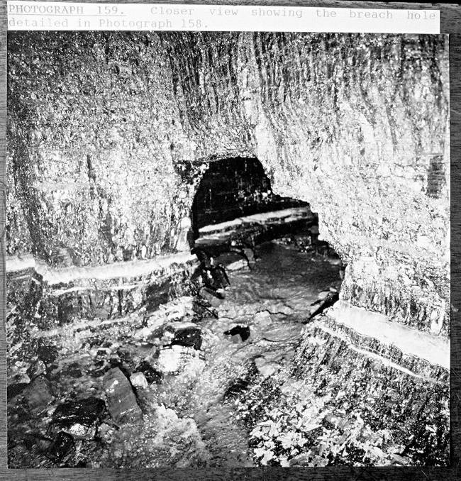
Case study: Gretley, Hunter Valley, NSW
14 November 1996 Principal Hazard – (ii) inundation or inrush
Pattern of failure:
Design engineering and maintenance flaws
Flawed maps of working.
2 . Failure to heed clear warning signals
Evidence of abnormal water prior to incident.
Flaws in risk assessment
Failure to assess risk of inrush.
7. Failures in regulatory oversight
Inadequate and poorly targeted enforcement activity.
Fatalities: 4 miners
Notes:
Suggested time for slides 31-36: 10 minutes (total)
NB: Slides 331-36 are the remaining case studies for the Facilitator to briefly touch on (Northparkes; Gretley; Cadia East).
Case study – Gretley Colliery, Hunter Valley, NSW.
Date
14 November 1996
Location
Gretley Colliery, Hunter Valley, NSW
Principal Hazard NSW Mining Legislation
(ii) inundation or inrush of any substance
Incident details
At about 5.30 am employees of The Newcastle Wallsend Coal Company Pty Limited were engaged in work on the night shift.
Four men from a team of eight were in the process of developing a roadway (known as C heading) in an area of the mine called 50/51 panel, operating a continuous mining machine. The remaining four members of the team were in a crib room a little distance away.
Suddenly, with tremendous force, water rushed into the heading from a hole in the face made by the continuous miner. That machine, weighing between 35 and 50 tonnes, was swept some 17.5 metres back down the heading where it jammed against the sides. The four men were engulfed by the water, swept away and drowned.
The remaining team members survived the disaster by reason of being in the crib room, which itself was flooded.
Human and organisational factors
Individuals and the organisation failed to recognise subtle warning signs.
The Mine Surveyor was new to role and did not sufficiently question the accuracy of plans of adjacent workings provided by the NSW Government and Mine Subsidence Board.
The Undermanager failed to respond to concerns raised by the Deputy or to investigate further when reports of water ingress were noted on inspection reports.
The Regulator failure to question absence of risk assessment.
Cost pressures were involved around dewatering the adjacent workings and the perception existed that approval for implementation of dewatering methods would not be granted.
Additional risk controls were due to be implemented but were not initiated in time to prevent the inrush (Drilling Ahead process).
Critical controls
Geo-technical data and systems of analysis
Inspection and monitoring arrangements
Training and competency of statutory processes for statutory roles
Systems of communication of information between shifts
Regulator over sight in relation to approvals for extraction
Patterns of failure
Pathway 1 Design engineering and maintenance flaws
Flawed maps of workings
Pathway 2 Failure to heed clear warning signals
Evidence of abnormal water prior to incident
Pathway 3 Flaws in risk assessment
Failure to assess risk of inrush
Pathway 7 Failures in regulatory oversight
Inadequate/poorly targeted enforcement activity
References
Report of a formal investigation under Section 98 of the Coal Mines Regulation Act 1982 by His honour Acting Judge J.H. Staunton (July 1998)
https://trove.nla.gov.au/work/8874656?q&versionId=46593902
“Ten Pathways to Death and Disaster”, Michael Quinlan (2014)
“Lessons from Gretley: Mindful Leadership and the Law”, Andrew Hopkins (2007)

Slide 35
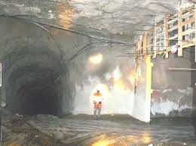
Case study: Cadia East Mine, Orange, NSW
21 February 2010 Principal Hazard – (i) Inrush
Pattern of failure:
1. Design, engineering and maintenance flaws
Drilling of tell-tale holes (not mandatory but best practice)
– offered higher level of risk control.
2. Failure to heed clear warning signs
Increased evidence of water.
Failure to respond to a shaft blocked with slurry.
3. Flaws in risk assessment
Failure to address risk from wet reamed material.
Job Safety Environment Analysis (JSEA) had not been reviewed since 2006.
Lower order hierarchy of control employed (manned v remote bogger).
Photo depicting height of water during inrush
Fatalities: 0
7 miners at direct risk
Notes:
Suggested time for slides 31-36: 10 minutes (total)
NB: Slides 31-36 are the remaining case studies for the Facilitator to briefly touch on (Northparkes; Gretley; Cadia East).
Case study – Cadia East Mine, Orange NSW
Date
21 February 2010
Location
Cadia East Mine, Orange NSW
Principal Hazard NSW Mining Legislation
(ii) inundation or inrush of any substance
Incident details
An inrush of mud and water from an almost completed ventilation shaft partially flooded the underground workings. The ventilation shaft was being formed by raise boring.
The inrush material travelled 814m along a roadway to the top of a second ventilation shaft where it continued to fall 375m down a shaft to a second level in the mine.
The inrush pushed a 57 tonne manned bogger (front end loader) for 30 – 40m along a roadway and pushed a 5.7m tonne unmanned mini excavator an unknown distance along a roadway.
Although no one died seven (7) people were directly exposed to the risk of serious injury or death.
“The dried mud left on the walls by the inrush was, in places, higher than a person. The height of the flow and the force would have had serious consequences for anyone caught in its path.” (P. 20)
“The inrush was the result of an excessive build-up of reamed cuttings choking the raise bore shaft at its base and the subsequent build up of water and cuttings in the shaft bursting out from the bottom of the shaft.” (P. 33)
Human and organisational factors
Supervisors failed to recognise or respond to the increased evidence of water in the hours leading up to the incident.
The organisation made the decision not to drill telltale holes.
The risk assessment process failed to effectively identify the scope of risks associated with the activity.
Critical controls
Training and competency management system for supervisors
Inspection and Monitoring arrangements
Safety Management System monitoring and review process
Patterns of failure
Pathway 1 Design, engineering and maintenance flaws
Tell-tale holes not drilled to release water. Although not mandatory a high reliability organisation would likely initiate this process as it offers higher levels of risk control within the hierarchy of control. (P. 29)
Use of a lower-order hierarchy of control (manned bogger) option in lieu of available remote-controlled bogger (substitution/isolation) to remove cuttings. (P.39)
Supervisor did not include the option of the remote-controlled bogger in the final risk assessment/Job Safety Environmental Analysis (JSEA) document. (P. 39)
Pathway 2 Failure to heed clear warning signals
Successive supervisors failed to respond to the increased evidence of water and the impact on the potential for inrush.
The area where the shaft was excavated was known to be a wet area. When the pilot hole was completed, water was seen flowing from the hole. It appears no specific arrangements were made to accommodate the reaming of a wet shaft. (P. 35)
Failure to recognise and respond to bogging delays (P. 39) – “The slurry material from the reaming process was causing blockages in radiator, and the bogger to be used on 21 February had broken fan belts.”
On this occasion three staff members (including a Supervisor) indicated that the shaft was blocked/choked on 3 occasions in the 24 hours prior to the incident.
Supervisor/consultant failed to reconcile cuttings bogged with amount reamed which would have identified risks. (P. 35)
There were also pre-warning signs from previous work undertaken which should have alerted supervisors to the non-contextual method of calculating the amount reamed. Method had been calculated using dry cuttings not wet cuttings. (P. 37)
Pathway 3 Flaws in risk assessment
A documented risk assessment was developed for Cadia East RB1 raise bore hole. The document was not updated for the raise boring activities taking place at the time of the incident. It did identify the risk of potential inrush from a blocked hole but the residual risk was classified as insignificant and rare.” (P.34)
…”risk assessment document did not address the risk from wet reamed material.”
No assessment of catastrophic failure of the material pile and subsequent inrush potential and consequently, a failure to identify the build-up of water in the shaft once it was blocked.” (P. 34)
JSEA had not been reviewed since 2006 which suggests failure to review its integrity and, where possible, continuously improve risk management systems and control outcomes indicating a normalisation of an inrush hazard.
Pathway 4 Flaws in WHS management systems
Failure to follow standard or safe work procedure (SWP) (P. 38)
The Inspector noted that communication regarding high risk activities may be relevant to the continued safe operation of the mine or the safety of people working at the mine. (P. 24)
The JSEA did not identify safer systems of work other than using the bogger on the lower side of the material pile when the material was known to be wet.
(P. 40)
A number of supervisors confirmed during interviews that the JSEA was not completed. (P. 40)
Pathway 5 Flaws in system auditing
The JSEA had not been reviewed since 2006.
No inspection of the bottom of the VR5A shaft had been completed by a qualified engineer. Instead inspections were conducted by Supervisors with no formal qualifications in geotechnical matters. (P. 34)
A reconciliation document provided by Cadia East mine failed to identify that there were less cuttings taken away than were created during the raise boring process. (P. 35)
Supervisor signed off poor quality JSEA having immediate knowledge that the risk controls in that document were not satisfactory in the circumstances that led to the incident (P. 20)
Line supervisors failed to have the JSEA signed off by higher management (OHS Consultant and superintendent) which was contrary to internal policies. (P. 41)
Pathway 6 Economic/reward pressures compromising safety
A decision was made by mine management about a week before the incident to permit the raise bore to cut as quickly as possible in order to complete the VR5A shaft. (P. 28)
References
Published Investigation Report prepared for the Director‐General of the Department of Trade and Investment, Regional Infrastructure and Services by the Mine Safety Investigation Unit, Thornton. NSW
https://resourcesandgeoscience.nsw.gov.au/__data/assets/pdf_file/0006/418416/Cadia-east-inrush-report-for-publication.pdf

Slide 36
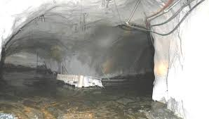
Case study: Cadia East Mine, Orange, NSW
Pattern of failure:
4. Flaws in management systems
Failure to follow Safe Work Procedure (SWP).
JSEA not completed correctly but signed off by supervisor.
5. Flaws in system auditing
Failure to reviews JSEA’s since 2006.
No inspection of bottom of VR5A by qualified engineer.
Failure to audit and reconcile the quantity of cuttings.
6. Economic/reward pressures compromising safety
Decision made to permit the raisebore to cut as quickly as possible in order to complete the VR5A shaft.
Photo depicting water during inrush
Fatalities: 0
7 miners at direct risk
Notes:
Refer to notes on first Cadia slide.

Slide 37
Pathways to success
An effective regulatory framework
Leadership and commitment from the mine operator and officers that builds confidence and trust
Effective health and safety management systems
Development and maintenance of successful communication systems across all levels of the organisation
Proactive and positive risk and hazard management processes that are embedded by everyone throughout the organisation
High levels of emergency management across prevention, preparation and response
Notes:
Suggested time for slides 37-42: 5 minutes (total)
Facilitator/key points:
The facilitator should work through this list and identify the positive pathways to reduce the risk of a serious safety incident. Ask participants if they believe there are any other pathways or features of organisations that enjoy optimal work health safety outcomes.

Slide 38
Next steps
What are strategies ensure that the messages and lessons from the 10 pathways analysis are shared with your workforce?
How do you know your mine is prepared for a disaster?
What have you done to prepare?
Notes:
Suggested time for slides 37-42: 5 minutes (total)
Facilitator/key points:
Conclusion and questions. Thank participants for their attendance at the program and draw attention to the final slide which includes additional resources.
The patterns of failure help to explain fatalities and serious injuries and confirm why poor safety cultures are a symptom of failure in WHS regimes and priorities.
Given the length of time since the last disaster, the industry is entering a dangerous period of potential complacency and everyone operating in this high risk sector must remain vigilant.
Previous downturns in the industry have led to job insecurity and industry/corporate restructuring. Organisations are constantly changing structures and introducing new technology which, if not managed effectively, could lead to disaster. Other risk factors can include, for example a significant increase in the use of subcontracted staff over a short period of time who may not be as familiar with the site and/or frequent changes to key management positions.
Encourage all participants, particularly those with statutory responsibilities how they will ensure that the messages and lessons from the ten (10) pathways analysis are passed on to their workforce.
Close with a series of confronting questions:
Is your mine prepared for a disaster?
What have you done to prepare?

Slide 39
Acknowledging the 17 people who died in work-related accidents in the NSW resources industry (1 July 2008 – 30 June 2018)
Darren Burgess, 48 | Mark Daniel Galton, 50
David Hurst Oldknow, 59 | James Leo Hern, 26
Daniel Gregory Hill, 34 | Judith Liehr, 49
Bruce Henry Austin, 57 | Ryan Anthony Messenger, 25
Peter Thomas Jones, 53 | Lee William Peters, 28
Jeremy Mathew Junk, 41 | Mark Siegel, 52
Ingrid Forshaw, 38 | Stephen Craig Norman, 53
Jamie Mitchell, 49 | Mark Brilley, 36
Phillip Grant, 35
Notes:
Suggested time for slides 37-42: 5 minutes (total)
Facilitator/key points:
Learning from experience, preventing devastating reoccurrences and improving the health and safety of all working in this industry is a profound way of acknowledging and recognising all those who have been impacted by mining safety incidents throughout history.

Slide 40
Support services available
Due to the potentially distressing nature of the video clips and content of the program, please note the following contact information for support services:
Beyond Blue: Phone: 1300 22 4636 (24 hours)
Web chat also available between 3pm and midnight at www.beyondblue.org.au
Lifeline: Phone: 13 11 14 (24 hours)
Web chat also available between 7pm and midnight at www.lifeline.org.au
Internal organisational welfare and support services
Notes:
Suggested time for slides 37-42: 5 minutes (total)
Facilitator/key points:
Remind all participants of the support services available to them should they find the content disturbing.

Slide 41
Acknowledgements
Special thanks to the following for their contribution in developing this package:
Rob Cunningham, Mining Operations Manager, Northparkes Mine
Professor Michael Quinlan
Mark Parcell - Mine Accident and Disaster Database
Radio New Zealand
Sonya Rockhouse
Anna Osborne
Notes:
Suggested time for slides 37-42: 5 minutes (total)

Slide 42
More information
Several texts and presentations focused on reviews of disasters and work health safety culture and leadership were used to inform this presentation including:
Australasian Mine Safety Journal - www.amsj.com.au
Hopkins, Professor Andrew Hopkins (Australian National University)
Hudson, Professor Patrick (Delft University, The Netherlands)
Mine Accident and Disaster Database www.mineaccidents.com.au
Mine Safety Institute of Australia, DVD – ‘A failure to learn’ (2014) DVD (Copies of the full DVD are available from www.PikeRiverDVD.com)
Mine Accident and Disaster Database www.mineaccidents.com.au
MSIA Coal Mine Disaster Recommendations Report (2017) https://www.minesafetyinstitute.com.au/
Statutory function description https://www.resourcesandgeoscience.nsw.gov.au/miners-and-explorers/safety-and-health/topics/statutory-functions
Quinlan, M. (2014) Ten Pathways to Death and Disaster: Learning from fatal incidents in mines and other high hazard workplaces, Federation Press, Sydney.
Reason, Dr James (University of Manchester)
Safework Australia http://www.safeworkaustralia.gov.au
Further information on NSW mining disasters is available on the NSW Resources Regulator website
Notes:
Suggested time for slides 37-42: 5 minutes (total)

