Slide 1
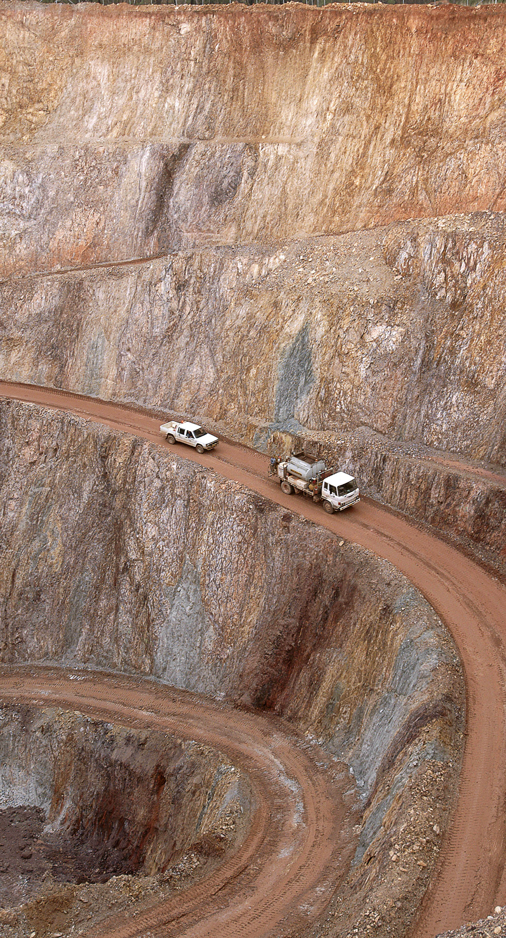
Lifting and Cranage Online Intervention
NSW Mining Industry
Anthony Margetts
Chief Inspector of Mines
14/12/23

Slide 2
Why are we here today?
Conducting this online intervention as a trial, in the place of a state-wide intervention process
Faster and more flexible, however relies on your response - no compliance enforcement action
If effective, will negate the need for a state-wide intervention
Encourage your feedback on this trial

Slide 3
Why are we here today?
Concerning recent trend of lifting and cranage incidents across NSW mining
In particular, we’ve seen an increase in incidents relating to haul truck maintenance, but the lessons apply across all lifting operations
Due to the current trend, any further lifting and cranage incidents will have additional scrutiny from the Regulator
A follow-up compliance priority will be run in H1 2024

Slide 4
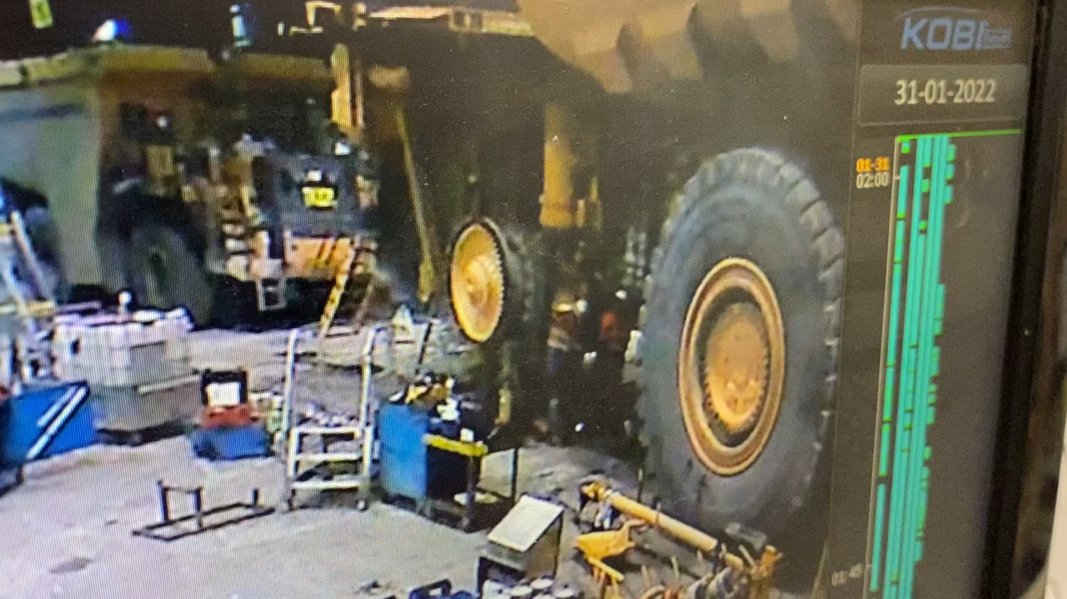
21 January 2022 – Komatsu 930E dump truck falling wheel hub and spindle
Notes:
Notes:
3 x workers in close proximity
No lifting jig being used, only a single jack stand not secured to hub
Whilst hub is attached to truck it is not a suspended load
Removing taper bolts to detach the hub
Workers not assessing that the hub will become a suspended load

Slide 5
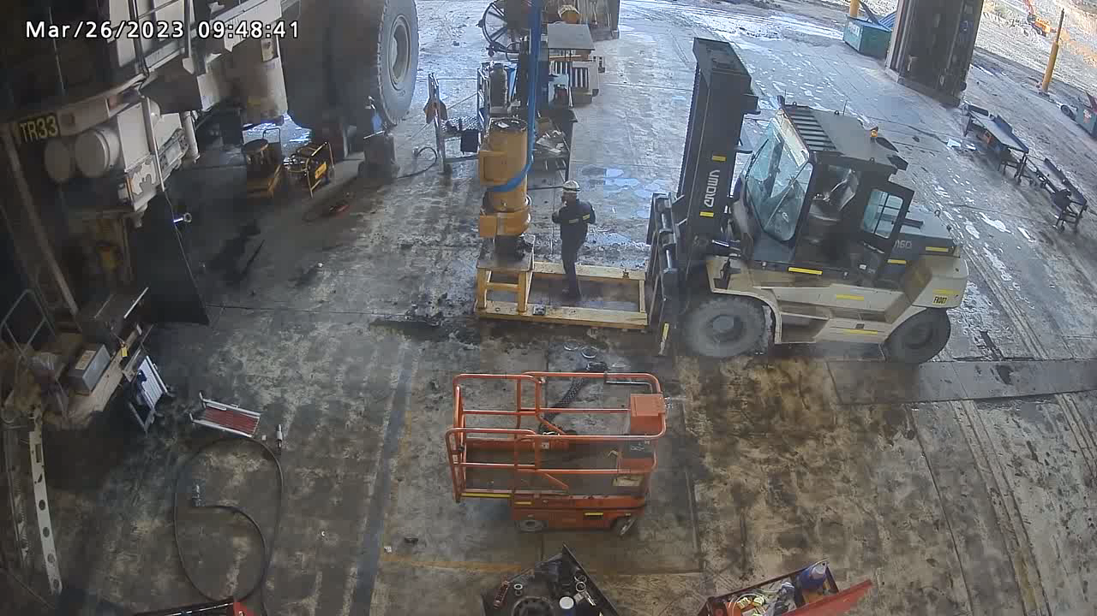
26 March 2023 - Komatsu 830E dump truck swinging wheel strut
Notes:
Notes:
Worker had sent the two other personnel off to lunch
Worker completed lifting certification 2 weeks prior to this lift
Worker could not find OEM strut lifting plate which would support the strut vertically from over head crane, but used a single sling instead of double slinging to balance the load
Worker identifies the strut is not stable even though it is still secured to forklift jig.
Worker introduces more energy into the system by further tightening the sling with the overhead crane.
Worker still works under the load, and positions themselves between the strut and the forklift thinking the sling will take the strut away from them when released.
Lack of understanding of mass and balance, as well as exclusion zones and swing zones

Slide 6
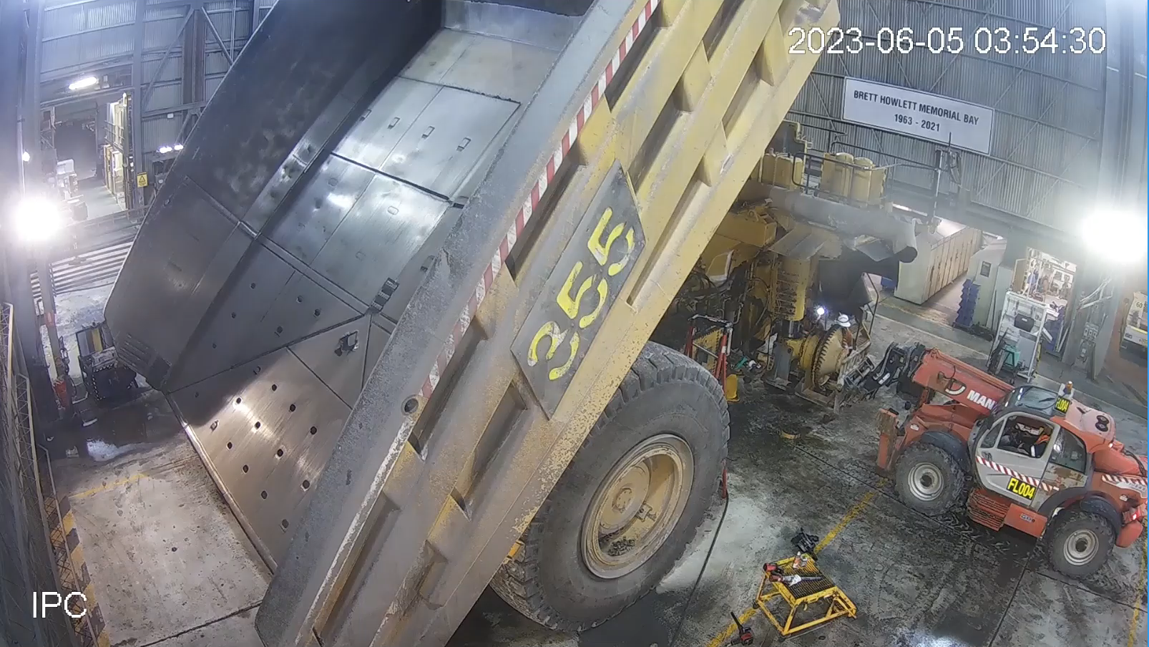
5 June 2023 - Caterpillar 789 haul truck falling wheel hub and spindle
Notes:
Notes:
Again separating the front hub from the strut in situ
3 x workers in close proximity
Suitable hub cradle on rated Manitou, but the front stab jacks are not set so the front tyres sag
No jack under the hub to prevent it dropping when it becomes a suspended load
Worker under the load undoing the taper bolts. That is their hard hat being spat out. Graze to workers head

Slide 7
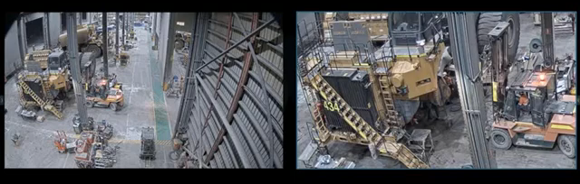
18 September 2023 - Caterpillar 795F haul truck falling wheel hub and spindle
Notes:
Notes:
Yet another disassembly of a front strut in situ
2 x workers in close proximity, one under the load undoing the taper bolts
Using a jib attachment on the forklift
No jack under the hub to prevent it dropping when it becomes a suspended load
Again that is their hard hat being spat out as they were knocked down.
Bruising to the other workers arm

Slide 8
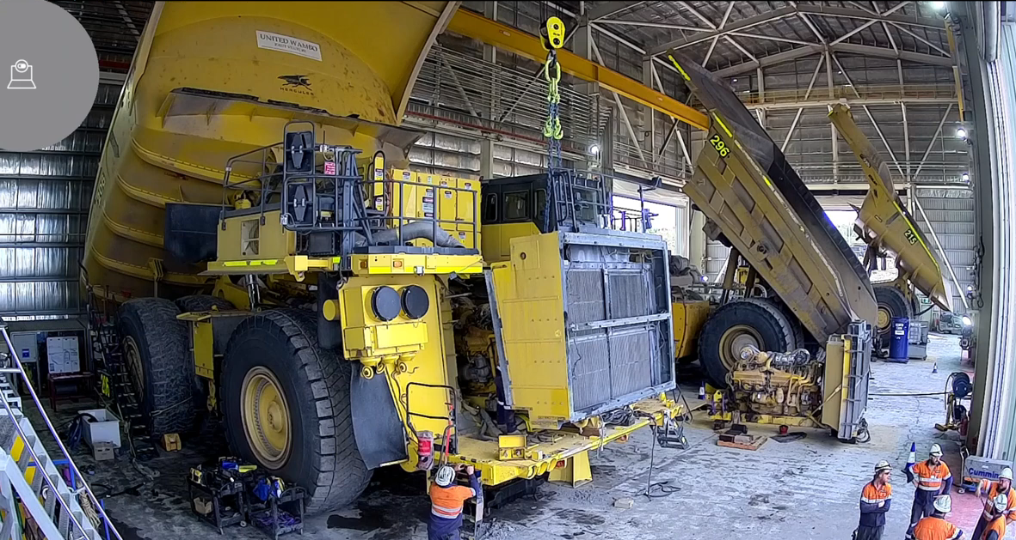
16 November 2023 - Komatsu 930E dump truck swinging cooling module (radiator assembly)
Notes:
Notes:
8 x workers on this job, 2 in the engine bay sides to guide module in
Normally the cooling module is installed whilst the truck is level and requires cumalongs in the engine bay to pull it back into position
Stand under the front of the truck and Pos 1 wheel removed so truck angled back
No reasonable JHA to identify effects of gravity, or control to fit cumalong on outside to prevent swinging load
Both workers in the engine bay had to jump clear

Slide 9
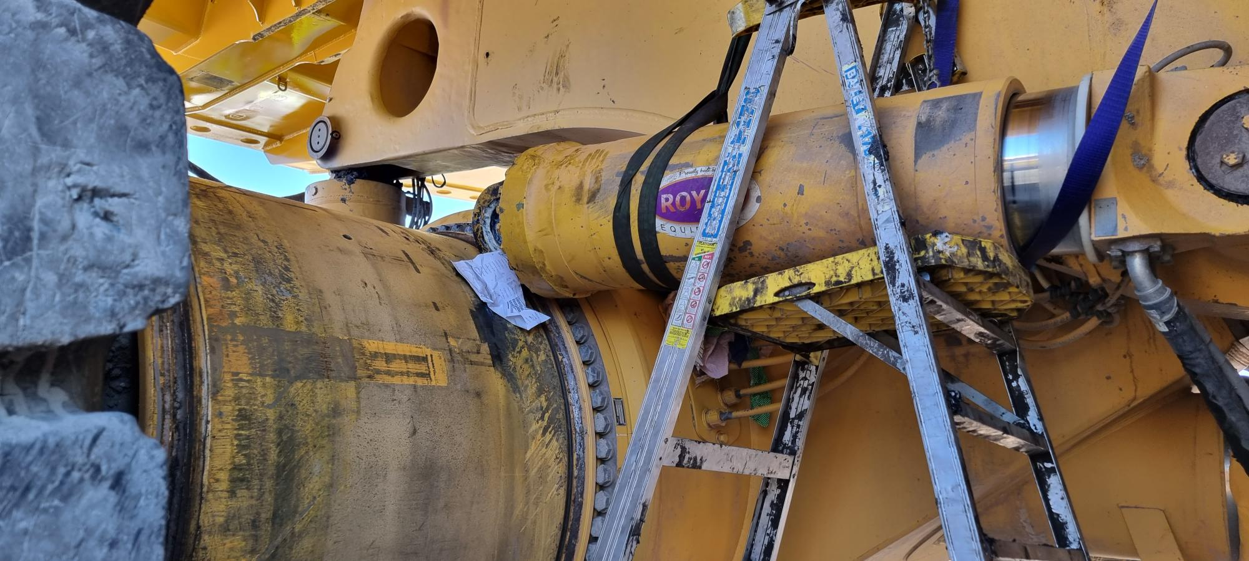
4 December 2023 - Komatsu 930E hoist ram slips pinning and braking workers' leg
Notes:
Notes:
Procedure not being followed
Ratchet strap being used rather than lifting gear

Slide 10
Incident History – Haul Truck maintenance
Date | Result | Description | Outcome
Jan-22 | Near Miss | Splitting hub off taper on truck, only supported by single jack stand, and hub rolls onto workshop floor | Three persons in close proximity, one beside hub. Near miss, evasive action
Nov-22 | Near Miss | Final drive assembly falls off power hoist due to missing retention chain, and stop start of jig | Electrician working under truck. Near miss, evasive action
Nov-22 | Severe Injury | Removing plate from rear axle box using overhead crane. Plate sprang off | Worker performing lift hit by plate resulting in compound fracture of lower leg
Mar-23 | Near Miss | Removing disassembled front strut from forklift jig supported by overhead crane and fibre sling | One person pushed between strut and forklift. Near miss, evasive action
Jun-23 | Injury | Splitting hub off taper on truck supported by Manatou with stab jacks not set | Three persons in close proximity, one under load. Evassive action, glancing blow to head
Sep-23 | Injury | Splitting hub off taper on truck supported by jib on forklift, lifts rear of forklift | Two persons in close proximity, one under load. Evassive action, bruised arm, knocked to ground
Nov-23 | Near Miss | Installing radiator module using overhead crane, pos 1 on stands, slides uncontrolled towards engine | Two persons in close proximity. Evasive action, near miss
Dec-23 | Severe Injury | Installing dump body lift cylinder. Lower chassis pin installed. Using ratchet strap and slips off cylinder | Cylinder rotates trapping worker between cylinder and axle box breaking lower leg
Notes:
Eight significant lifting task incidents in less than 2 years related to haul trucks

Slide 11
Incident History
Severe Injury
Injury
Note:
Decreasing time between incidents
Increasing severity of incident outcomes
Notes:
If we look at this graphically we can clearly draw two conclusions:
The time between incidents is decreasing
The severity of incidents is increasing

Slide 12
What do these incidents have in common?
An assembly on a haul truck being detached, disassembled, or reassembled
Incident occurs whilst the loads are separated from the truck and suspended
Loads are slung by qualified doggers/riggers using suitably rated lifting gear
Load often not supported using OEM or after-market specifically designed lifting jigs
OEM procedures are available, but often not applicable for the task or not followed
      JHA/JSA developed, but lack detail and do not identify known hazards or effective controls
      Workers are not aware or prepared for the change in load, including gravity, centre balance, swinging load, or the response of the lifting device (overhead crane, mobile crane, forklift, etc)
      Workers do not consider the loads’ transition to suspended loads when removing them
      Workers’ responses are instinctive rather than planned
Notes:
There are many common factors, including:
Incidents occurred whilst the item was detached from the haul truck
Specific jigs were unsuitable or could not be found
OEM procedures were available, but either not applicable or not followed
Known hazards and effective controls were not identified in the JSA / JHA
Workers were not aware of how loads would react during the lift

Slide 13
Contributing factors identified by Resources Regulator
Load related:
Lack of understanding of mass and balance of the supported component
Lack of understanding of the magnitude of stored energy in the suspension strut
Failure to use original equipment manufacturer (OEM) designed or supplied jigs
Poor suspension or support practices relating to the component, including:
— single point of support
— crane not positioned directly over the load
— outriggers not used to brace telehandler
— strut dynamic energy greater than fork / telehandler applied restraining force
Notes:
Read

Slide 14
Contributing factors identified by Resources Regulator
Process related:
Workers placing themselves below supported or suspended loads – line of fire
Risk assessment for the work lacked specific details of the job, and failed to identify high risk steps and / or associated controls
OEM and / or mine maintenance safe work procedures do not cover the complete scope of work for the job, including the:
— removal of the hub independently from the suspension strut
— removal of suspension strut from support jig
— disassembly and reassembly of the suspension strut
— reinstallation
Notes:
Read

Slide 15
Recommendations by RR
Maintenance personnel at mines and coal handling facilities should:
identify the full scope of work for the job
review the suitability of existing safe work procedures for all, or part, of the job
assess the risks associated with any portion of the work not covered by safe work procedures, including the work integration with the existing procedures
identify suitable controls and effective verification required to mitigate risks to as low as reasonably practical
ensure all tools, jigs, lifting equipment, and mobile plant are fit for purpose and available
ensure all workers are trained and competent in the work to be performed
assess maintenance work practices, especially in relation to worker positioning around suspended or supported loads, for lifting and cranage tasks, including exclusion zones and swing zones
ensure adequate supervision of complex tasks and lifts, especially with respect to the position of personnel in proximity to suspended or supported loads, and signing off permits
Notes:
Recommendations include:
Review procedures and ensure they cover the full scope of the proposed works
Risk assess any gaps in procedures, and implement effective controls
Consider worker positioning such as exclusion and swing zones
Lift studies and permits are completed
Ensure all equipment is fit for purpose and available
Workers are adequately trained
Suitable supervision is involved

Slide 16
Key Messages for Senior Leadership
Conduct a thorough review of ALL lifting and cranage operations at your site:
        Review the suitability of lifting equipment, procedures and practices
        Review the thoroughness of pre-task risk assessments
        Assess the adequacy of supervision of lifting tasks
        Assess training & competency of workers involved
    Don’t simply rely on outsourcing of this hazard to third party experts – you are the duty holder

Slide 17
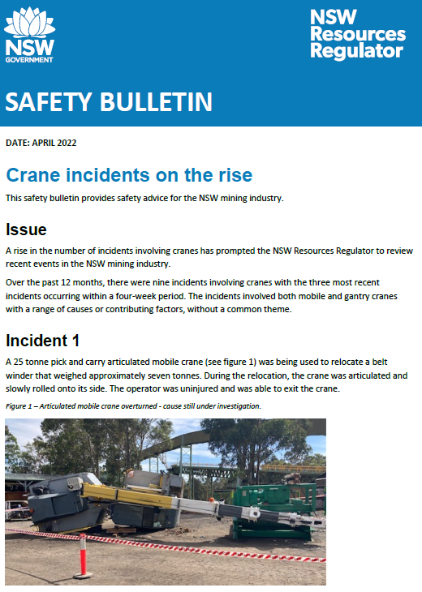
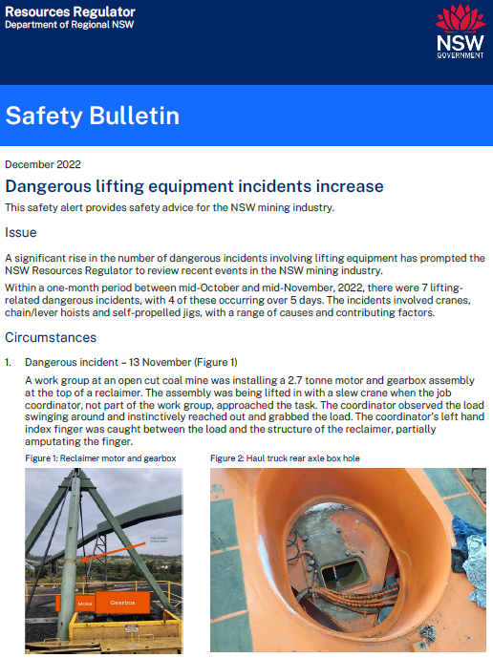
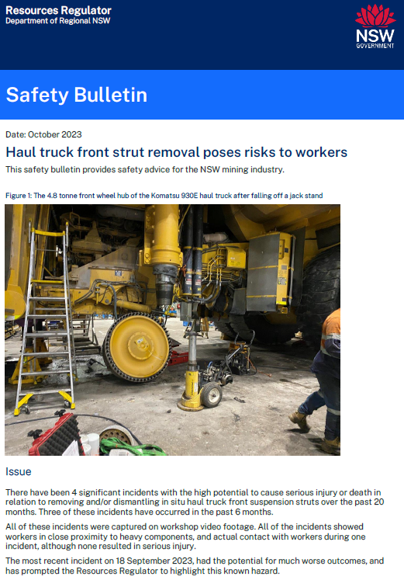
Recent publications
SB22-05 Crane incidents on the rise – April 22
  3 x general incidents with cranes
      mobile crane roll over
      poor load position
      OH crane brake failure
SB22-14 Dangerous lifting equipment incident increase – Dec 22
  7 x lifting incidents within a month
      UG and surface coal
      Five resulted in injury including broken leg, part of finger amputated, and three head injuries
SB23-08 Haul truck front strut removal poses risks to workers – Oct 23
  4 x similar lifting incidents
      Two resulted in injuries
      Poorly risk managed changes to OEM procedures
      Equipment not fit for purpose or incorrectly used
      Working around and under loads that become suspended
Notes:
Safety Bulletins have been issued as the Resources Regulator concerns grow around Lifting and Cranage.
Since the Safety Bulletin in October a safety alert was drafted for the incident in November, but had not been issued before the next incident occurred in early December.

